Slide 1
Big Data – Spark Hands-On 1
Arnaud Nauwynck - Sept 2023

Slide 2
Objectives
1/ Install on your (Windows) PC a minimalist local SPARK
2/ Configure it, launch spark-shell
3/ Discover spark-shell scala> REPL
4/ Exercises 1,2,..16 : … to Execute basic spark commands on DataSets

Slide 3
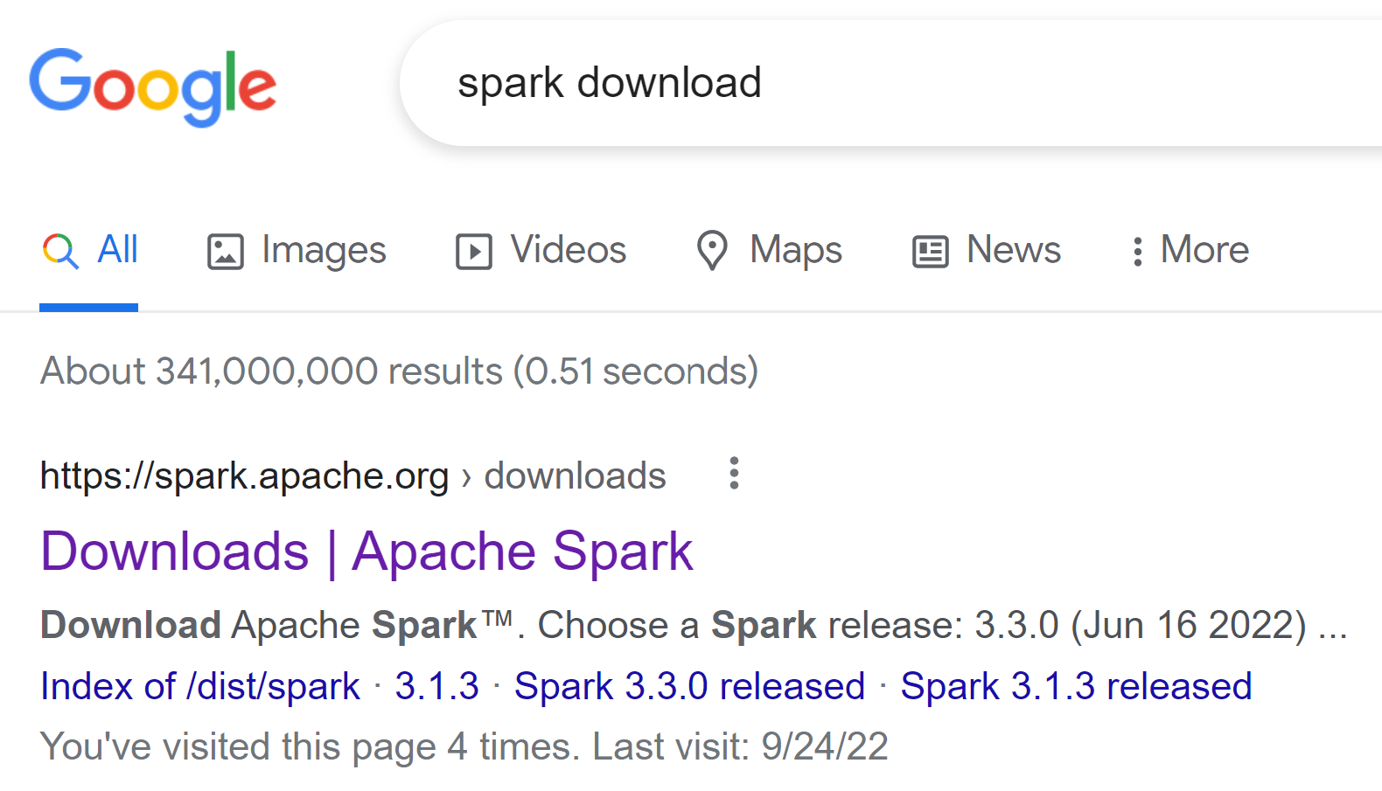
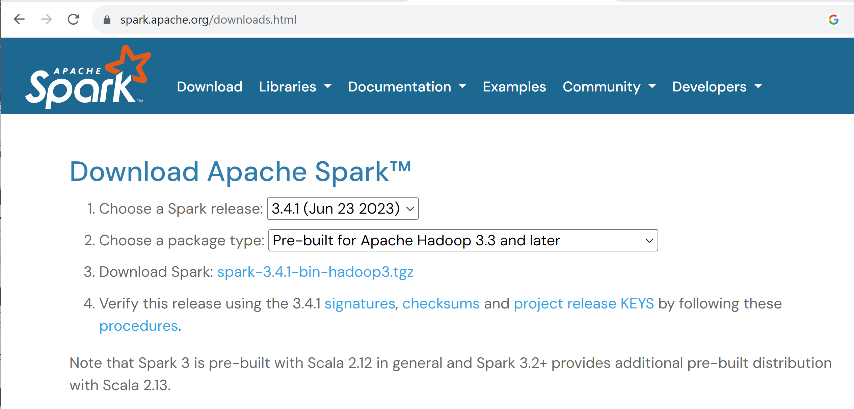
Step 1: Download Spark
https://spark.apache.org/downloads.html

Slide 4
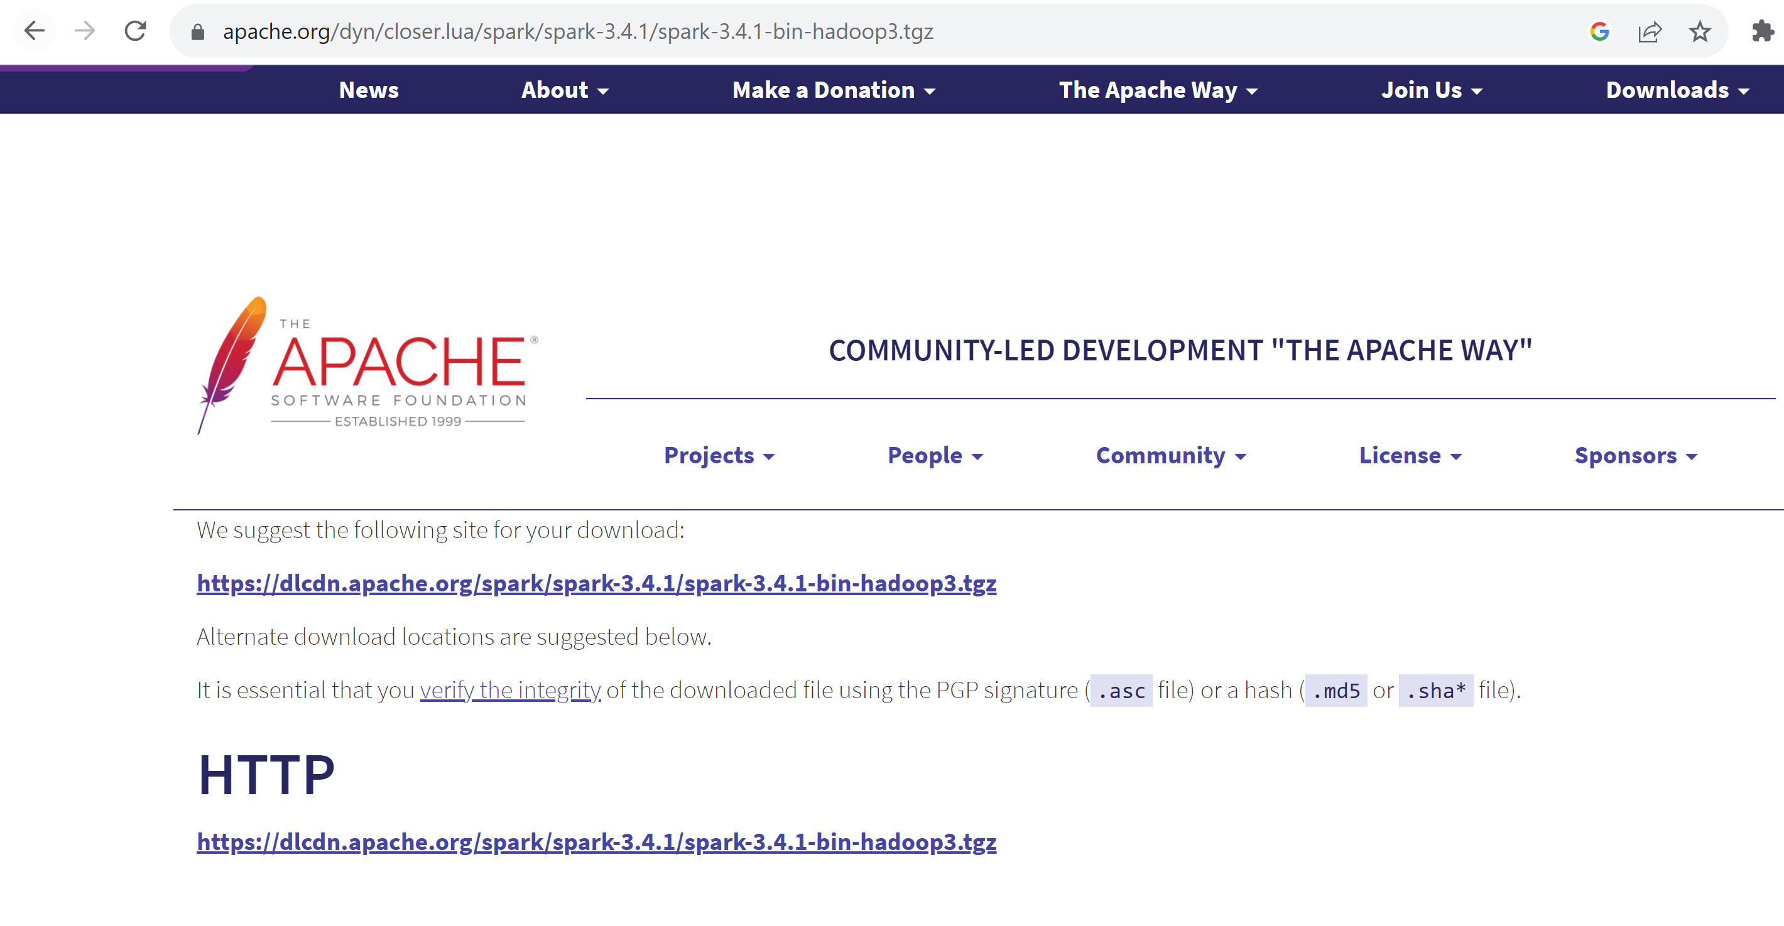
Download..

Slide 5
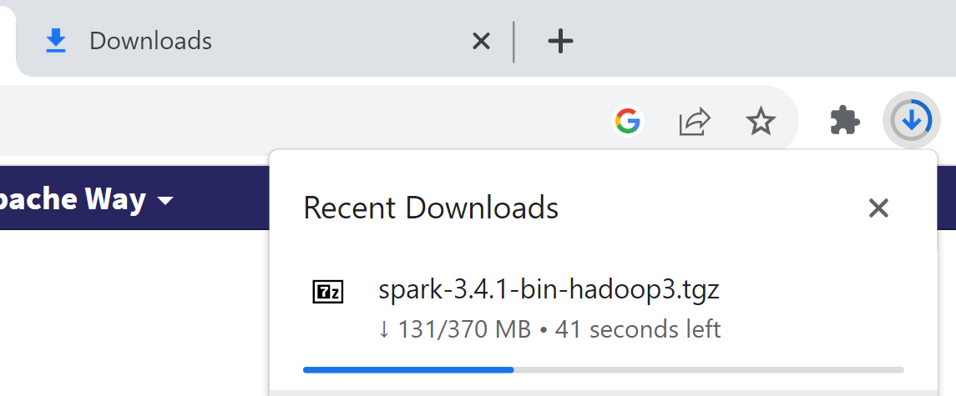
Download .. Be patient … 370 MB
( cf also Step 3 : another download for JDK next !! … 100MB more )

Slide 6
Step 2: Unzip for example in C:\apps\hadoop\spark
From cygwin / Linux ? => simply type « tar zxf spark*.tgz »
From Windows …

Slide 7
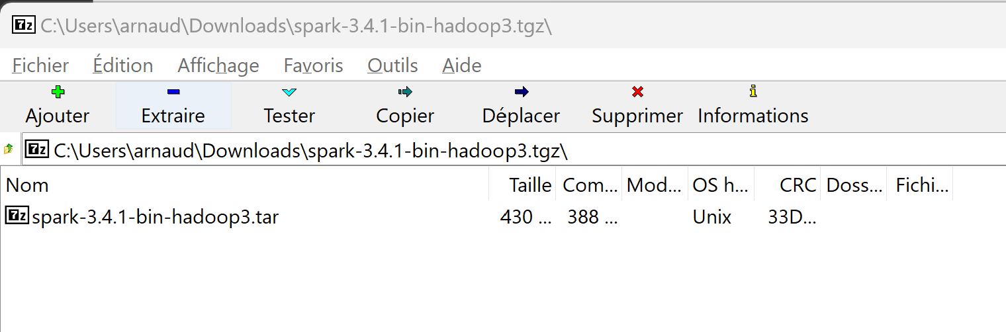
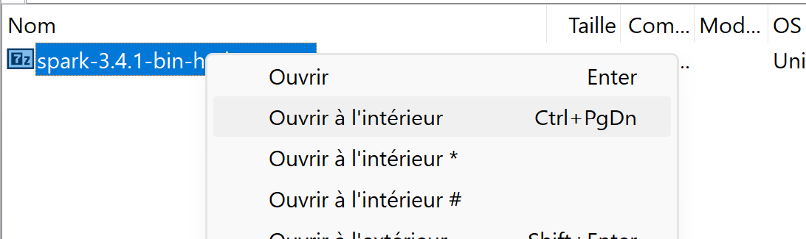
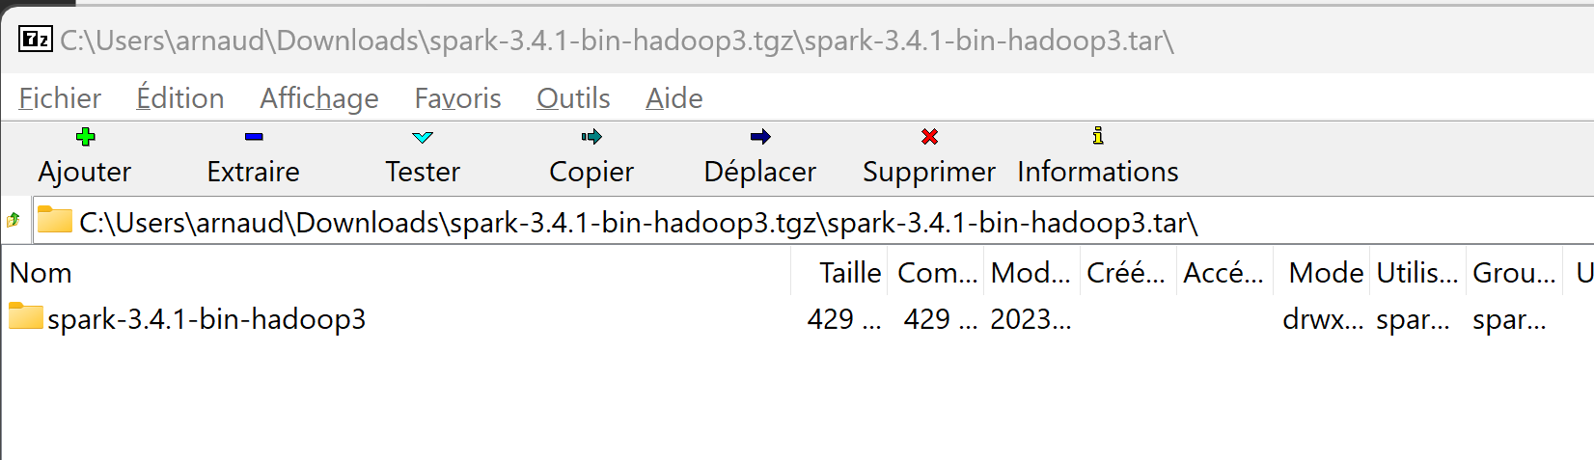
7-Zip … not very user-friendly for « .tar.gz »
First unzip …. 7-Zip only understand the « .gz » suffix out of « .tar.gz »
=> You extract a « .tar » file …. Then you redo extract from this file !

Slide 8
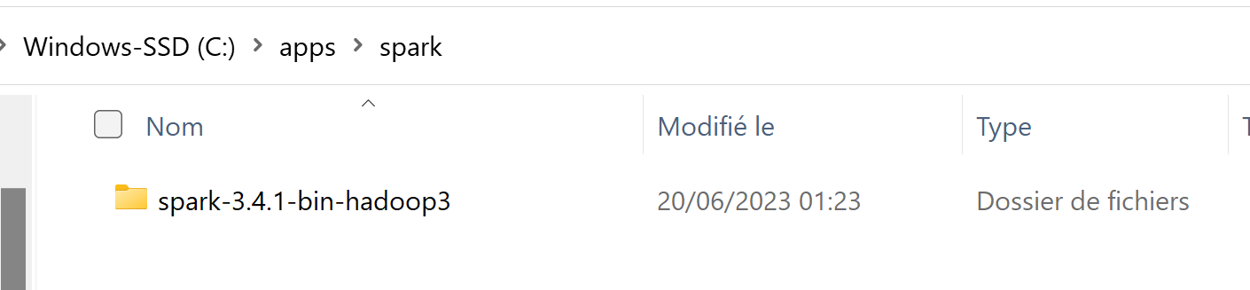
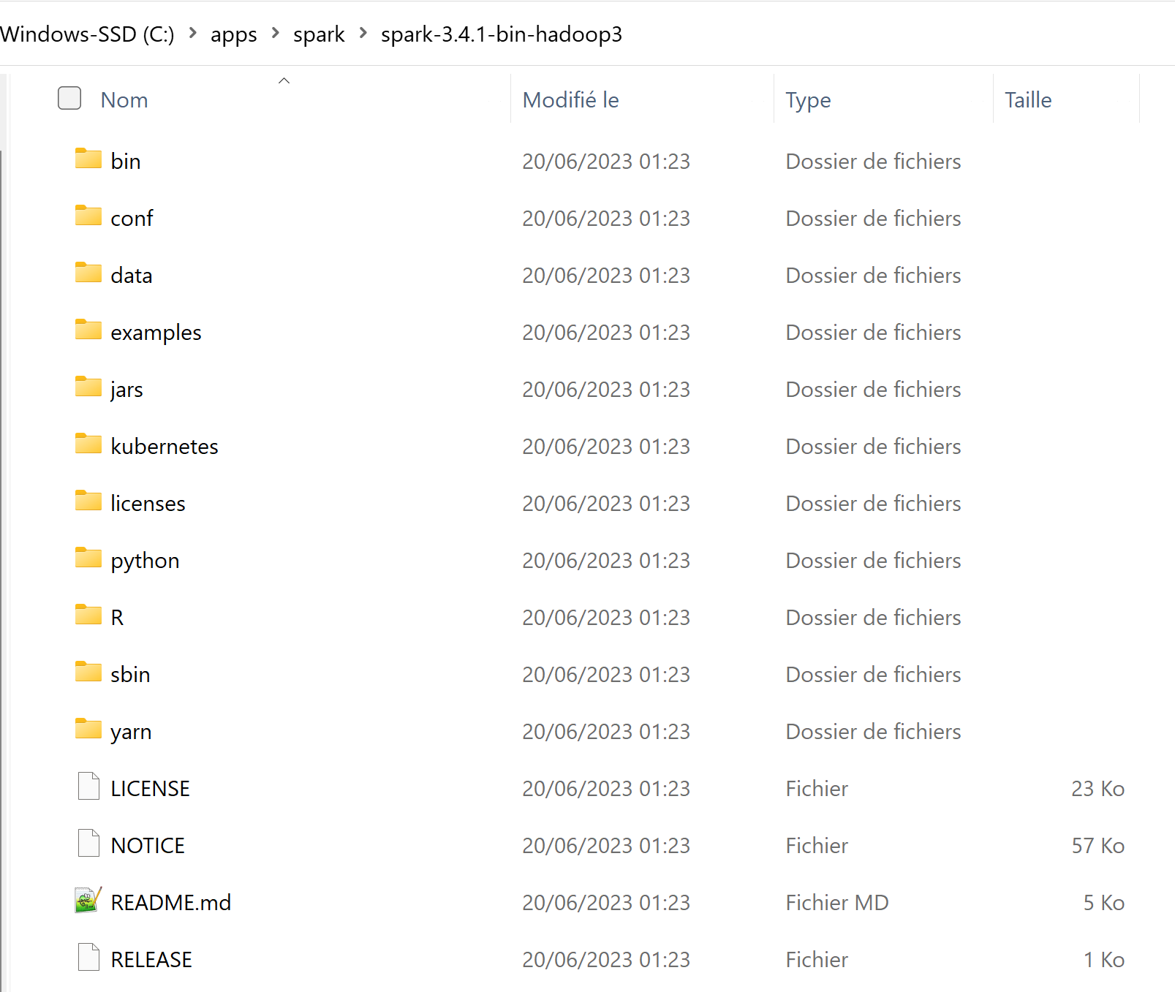
Step 2… check extract « .tar » file!
Simplify… move and rename sub-sub dir
to « c:\apps\hadoop\spark »
your version may be 3.4.xx
!= 3.3.0 … screenshot from oct 2022
warn on next slides for your exact dir path!

Slide 9
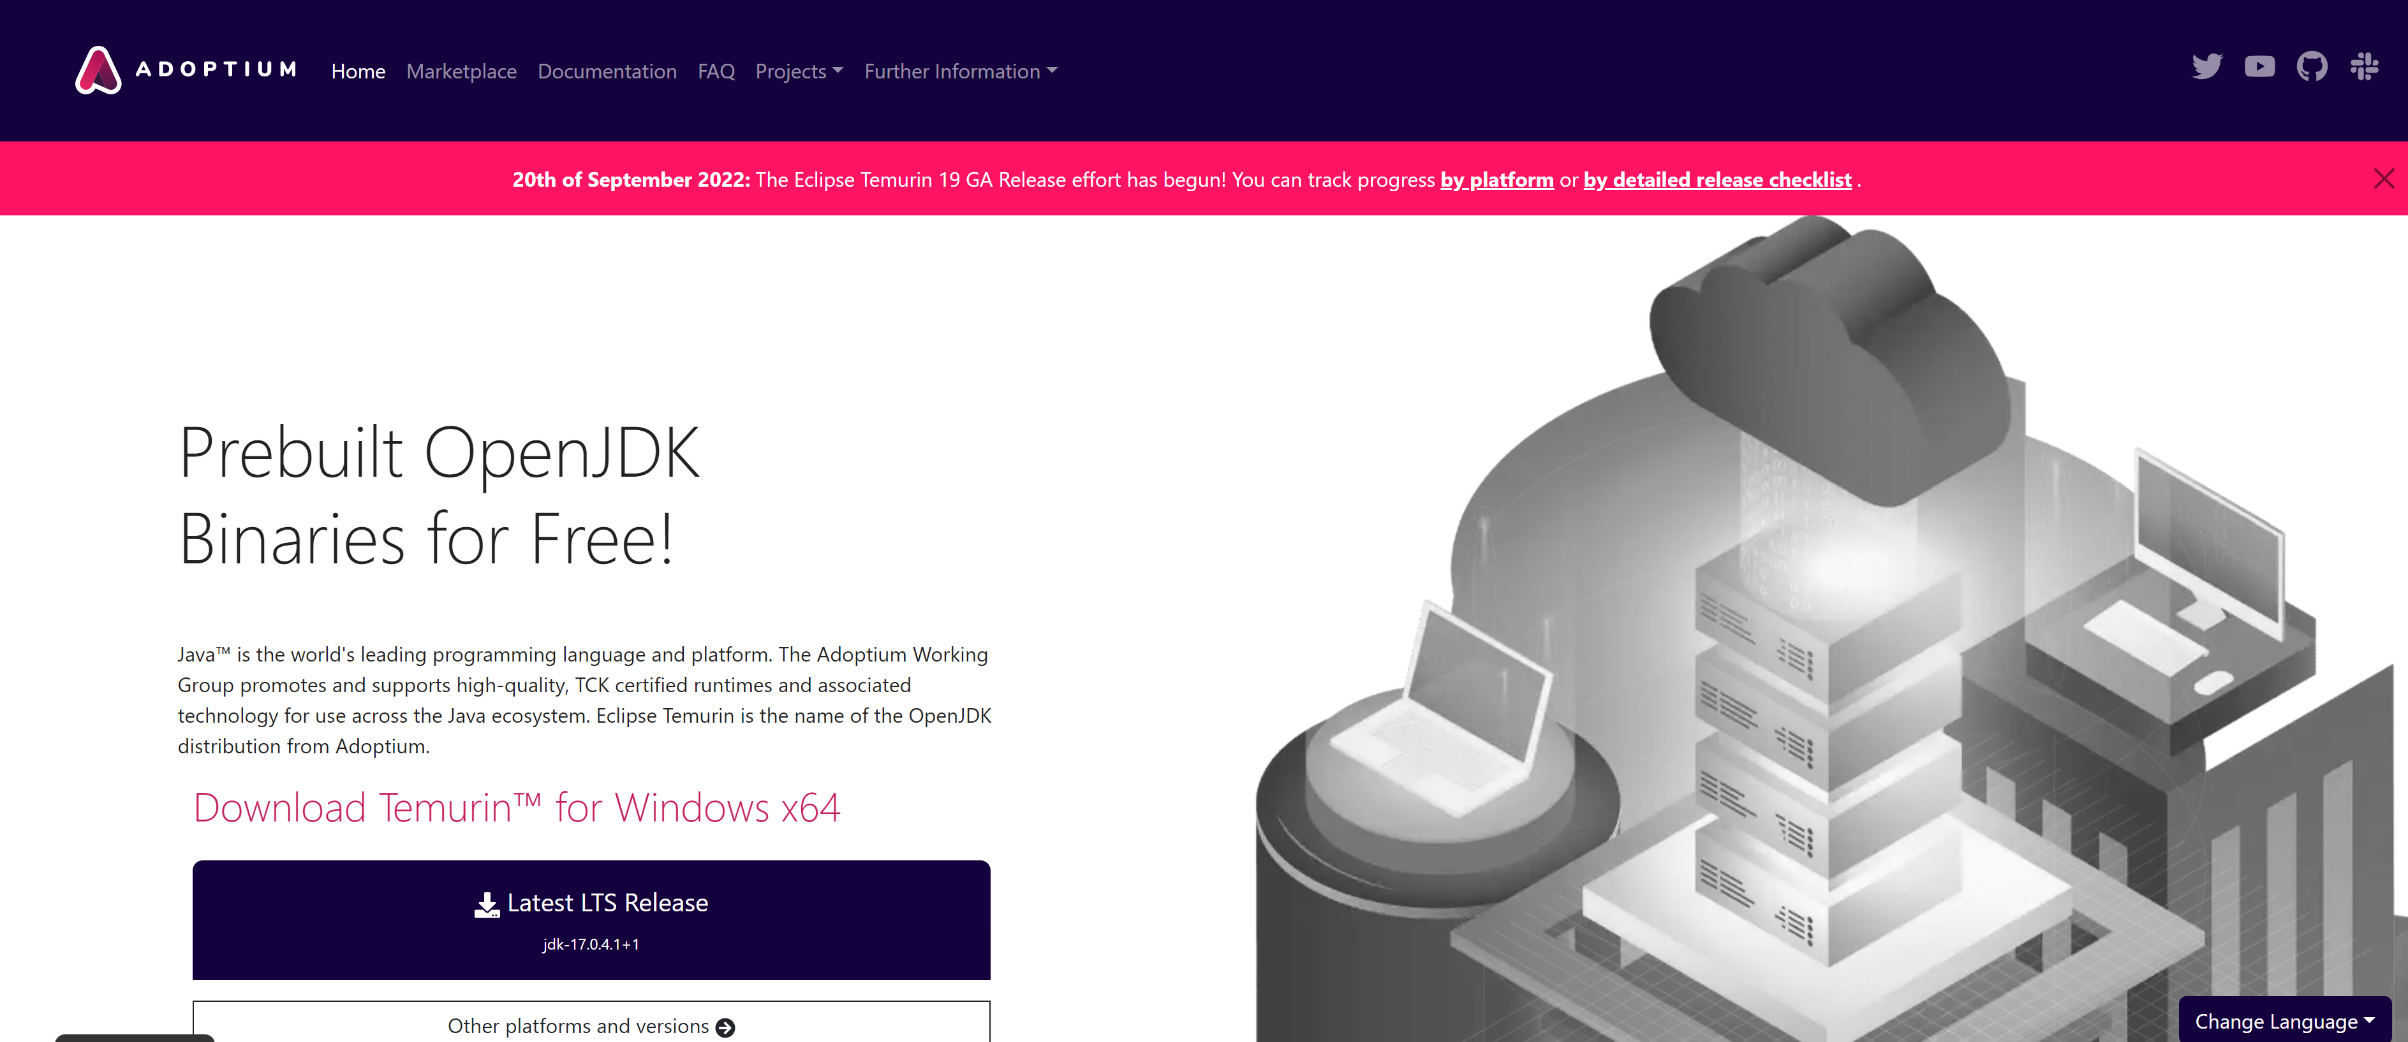
Step 3: Pre-requisite Install JDK 17
Notice: most of Hadoop still use Java 8+linux.. But cmd error on windows?
JDK is Open-Source, but pre-built binaries may be licenced if downloading from oracle.com
Download from « adoptium » (previously « adoptOpenJdk »)
https://adoptium.net/

Slide 10
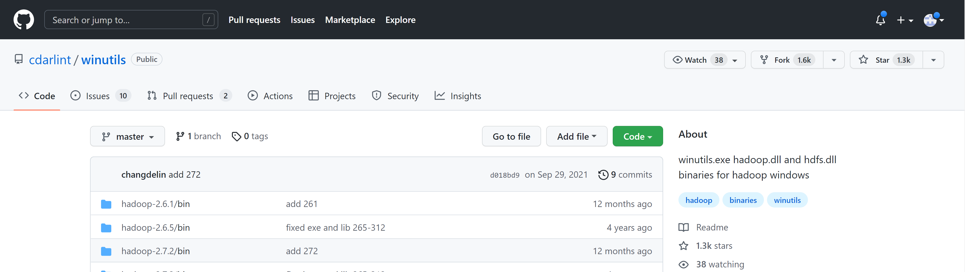
Step 4: on Windows only Download « WinUtils »
copying 2 files => from DVO > Course Spark > « TD1 »
hadoop.dll + winutils.exe in your Spark\bin
https://github.com/cdarlint/winutils
OR ELSE (more difficult)
If you want to copy
from Source directly
.. Cf 2 Files to extract from

Slide 11
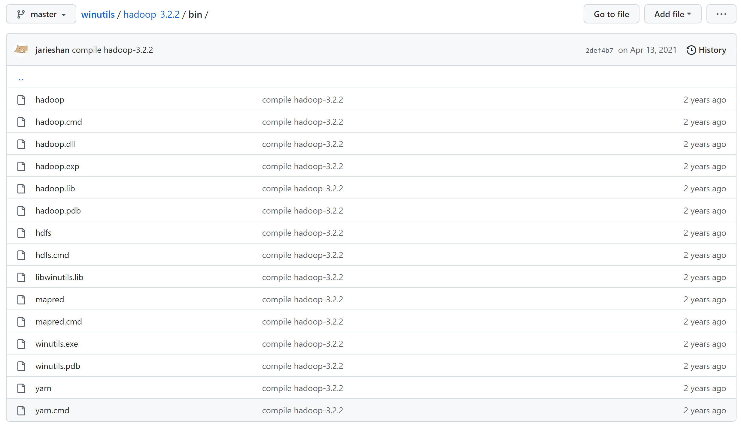
Step 4… Copy winutils.exe, hadoop.dll to you Spark \bin\

Slide 12
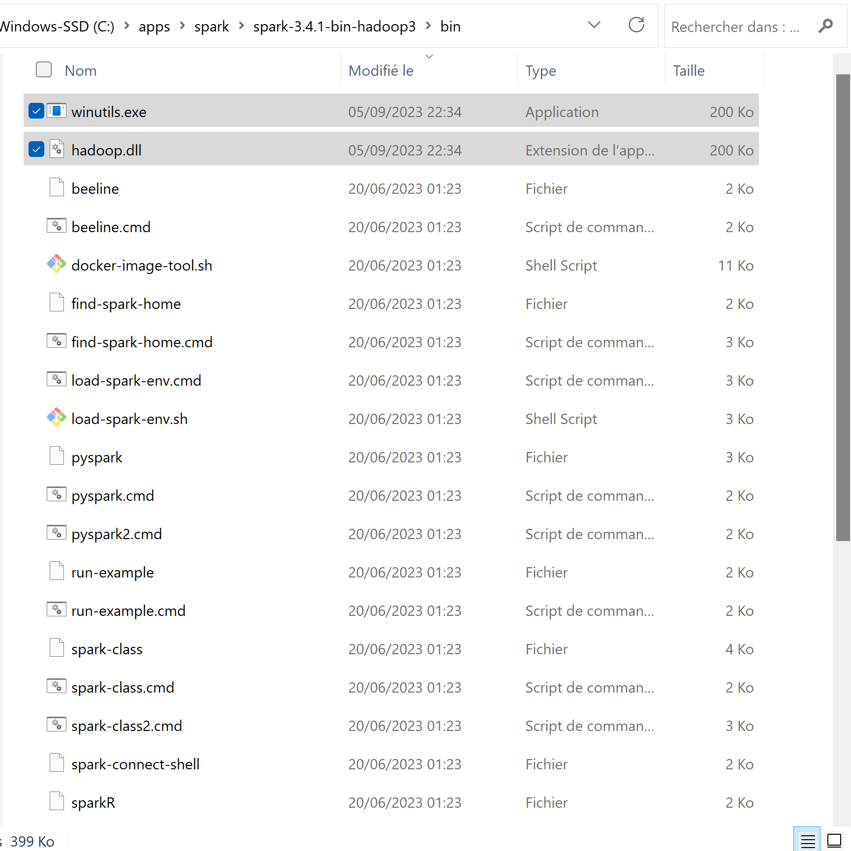
Check Copied 2 Files in spark…. \bin

Slide 13
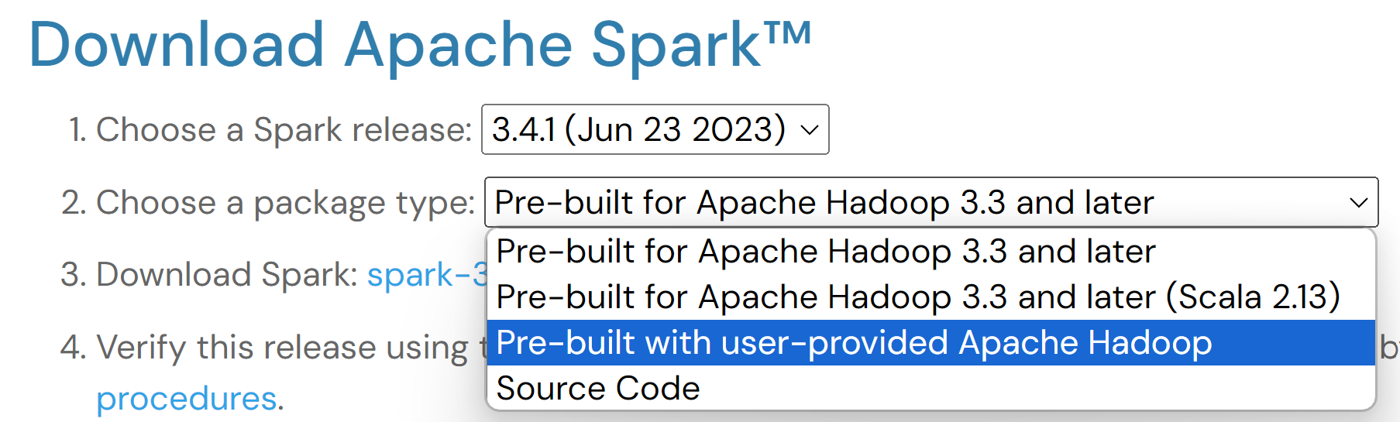
Step 5-a/ … optionnal … ( … for more possible customization on Hadoop configuration files )
Also Download Hadoop separatly !! (cf next slide)
AND Re-download spark, choose package type = « with user-provided Apache Hadoop »

Slide 14
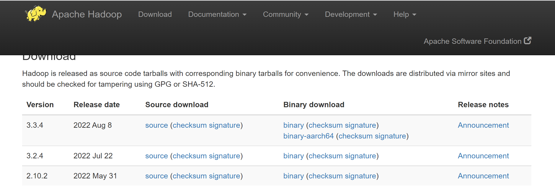
Step 5-b/ … optionnal … Download user-defined Hadoop
https://hadoop.apache.org/releases.html

Slide 15
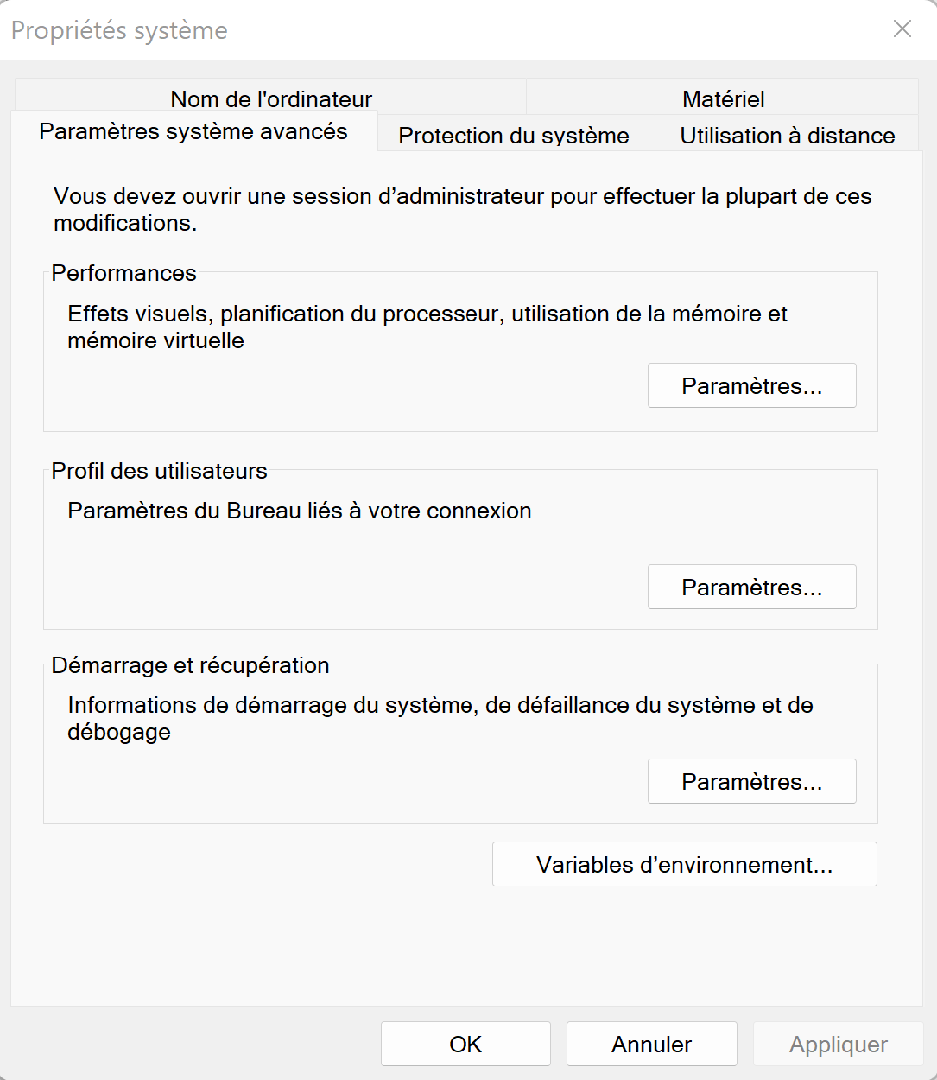
Step 6 : Configure Environment Variables
Download file for DVO > Course Spark > TD1 > File « setenv-**.cmd »
Either save it as « c:\apps\setenv-spark-3.xxx.cmd »
This file as to be executed each time you start a terminal !
(typicall in « .bashrc » for bash shell or conf in Cmder )
OR copy&paste all vars to Edit your Windows System Environment Variables !!!

Slide 16
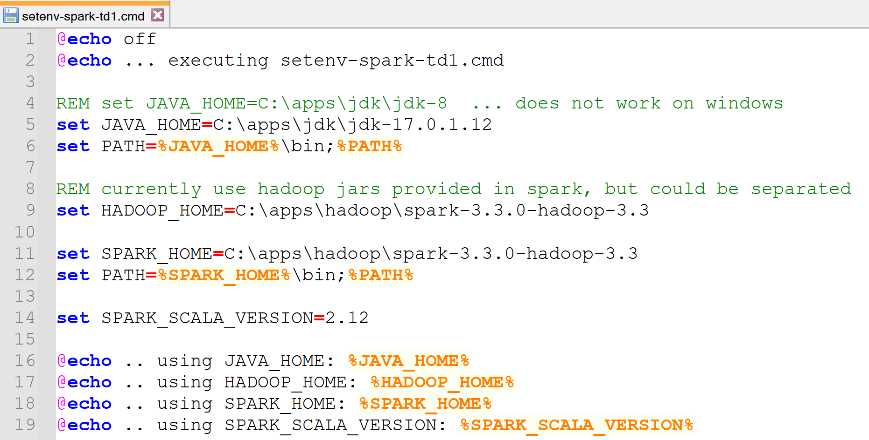
Step 6: set JAVA_HOME , PATH, SPARK_HOME, SPARK_SCALA_VERSION HADOOP_HOME
OLD screenshot for spark 3.3.0 !!!!
=> Adapt for spark 3.4.0 …. In particular check upgrade to SPARK_SCALA_VERSION=2.13

Slide 17
Step 6… optionnal … If using explicit user-defined Hadoop … also need spark-env.{sh|cmd} SPARK_DIST_CLASSPATH=$( hadoop classpath )

Slide 18
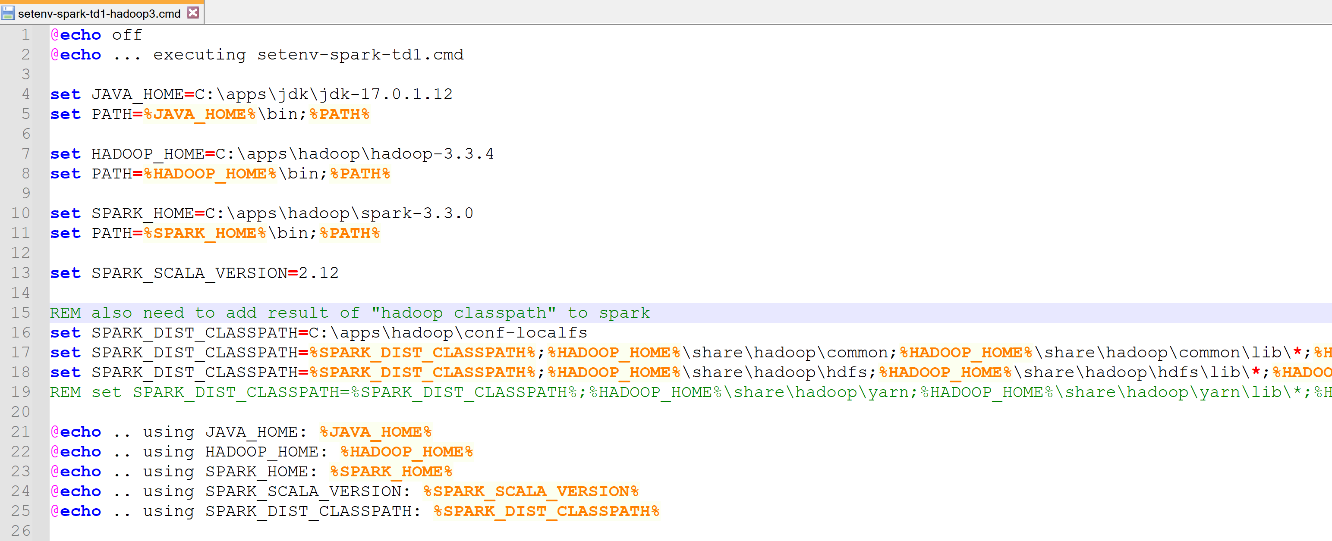
Step 6… optionnal … if using explicit HADOOP_HOME (recommended for fine-grained configuration / versions)

Slide 19
Step 6 … Error if forgetting SPARK_DIST_CLASSPATH
NO Detailed!!! … Internally spark-shell expand to command =>
C:\apps\jdk\jdk-17.0.1.12\bin\java
-cp "C:\apps\hadoop\spark-3.3.0\bin\..\conf\;C:\apps\hadoop\spark-3.3.0\jars\*;C:\apps\hadoop\conf-localfs"
"-Dscala.usejavacp=true" -Xmx1g -XX:+IgnoreUnrecognizedVMOptions
"--add-opens=java.base/java.lang=ALL-UNNAMED" "--add-opens=java.base/java.lang.invoke=ALL-UNNAMED" "--add-opens=java.base/java.lang.reflect=ALL-UNNAMED" "--add-opens=java.base/java.io=ALL-UNNAMED" "--add-opens=java.base/java.net=ALL-UNNAMED" "--add-opens=java.base/java.nio=ALL-UNNAMED" "--add-opens=java.base/java.util=ALL-UNNAMED" "--add-opens=java.base/java.util.concurrent=ALL-UNNAMED" "--add-opens=java.base/java.util.concurrent.atomic=ALL-UNNAMED" "--add-opens=java.base/sun.nio.ch=ALL-UNNAMED" "--add-opens=java.base/sun.nio.cs=ALL-UNNAMED" "--add-opens=java.base/sun.security.action=ALL-UNNAMED" "--add-opens=java.base/sun.util.calendar=ALL-UNNAMED" "--add-opens=java.security.jgss/sun.security.krb5=ALL-UNNAMED"
org.apache.spark.deploy.SparkSubmit
--class org.apache.spark.repl.Main --name "Spark shell" spark-shell

Slide 20
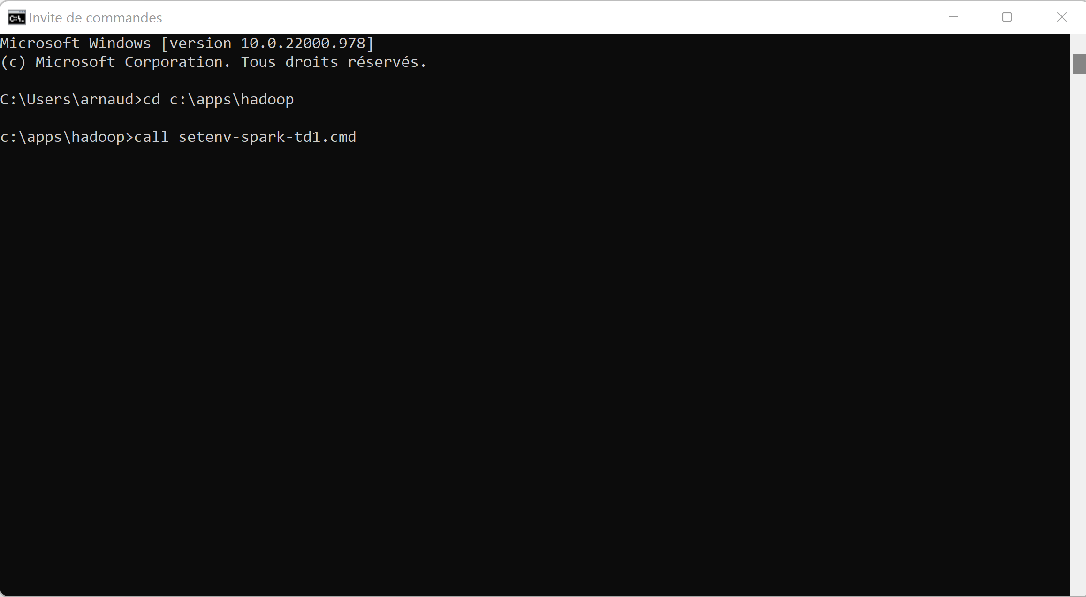
Step 7: Sanity Checks …
Windows > cmd cd <yourdir>
call <your-setenv>.cmd

Slide 21
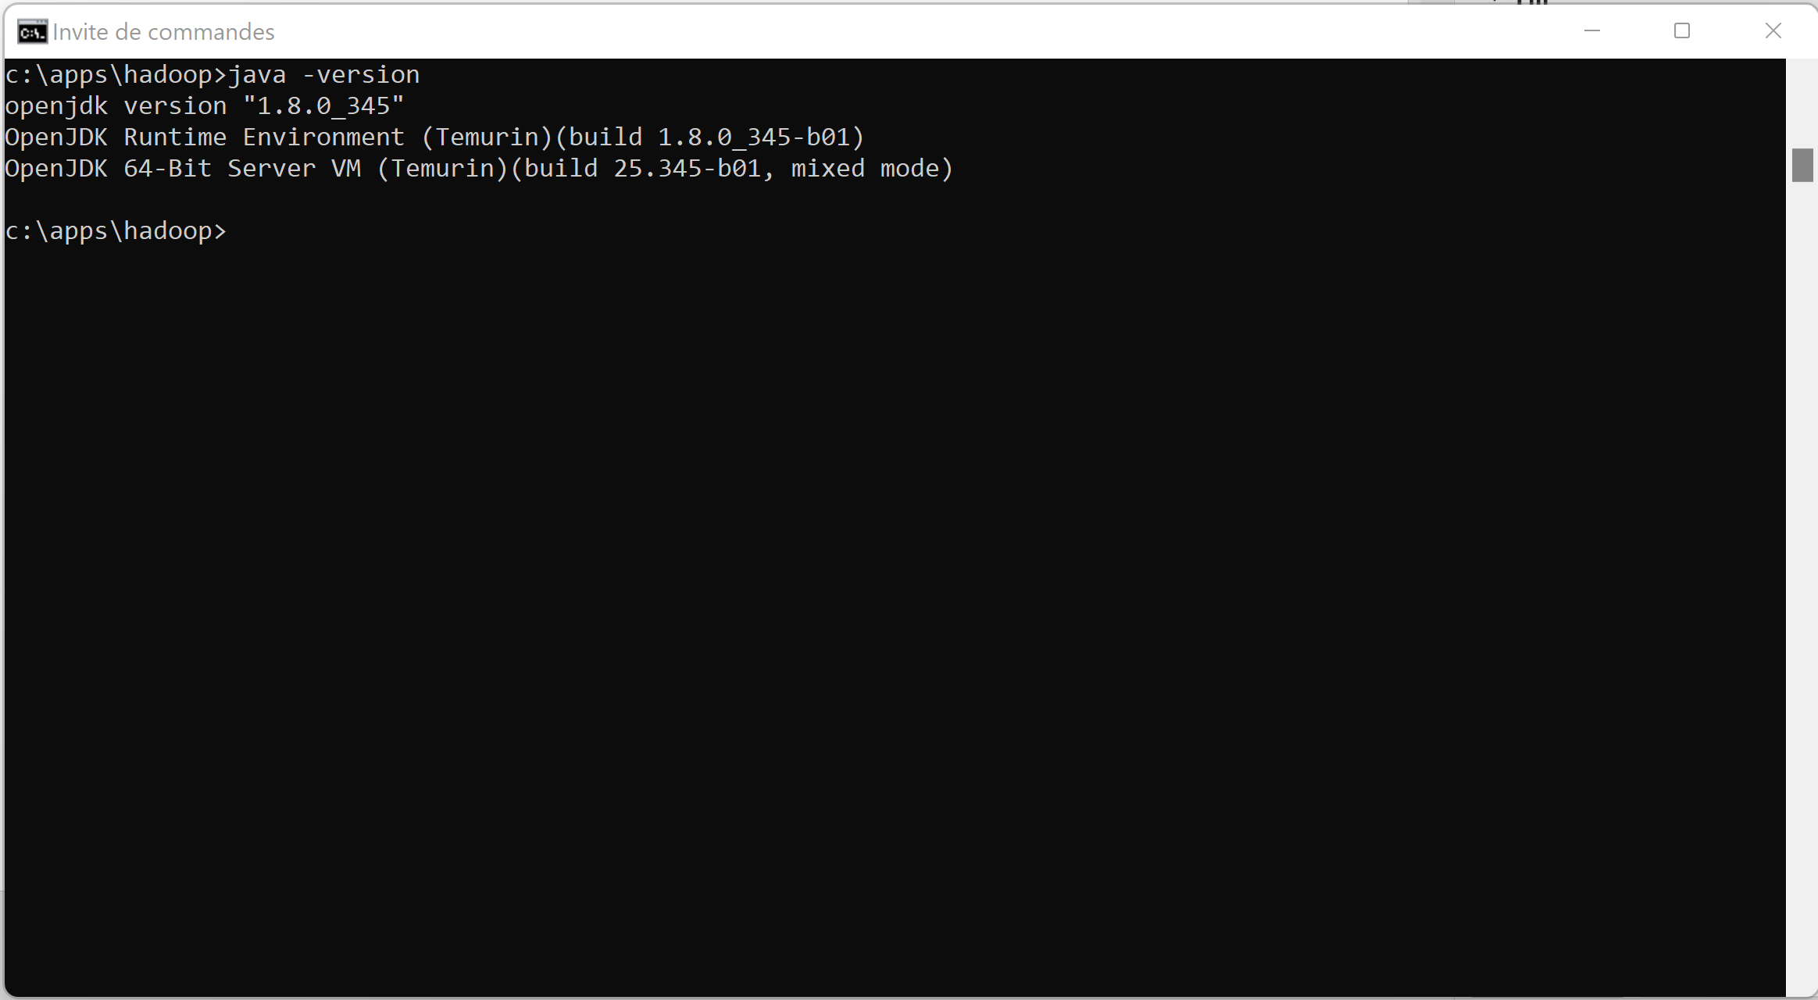
Sanity Check: Java

Slide 22
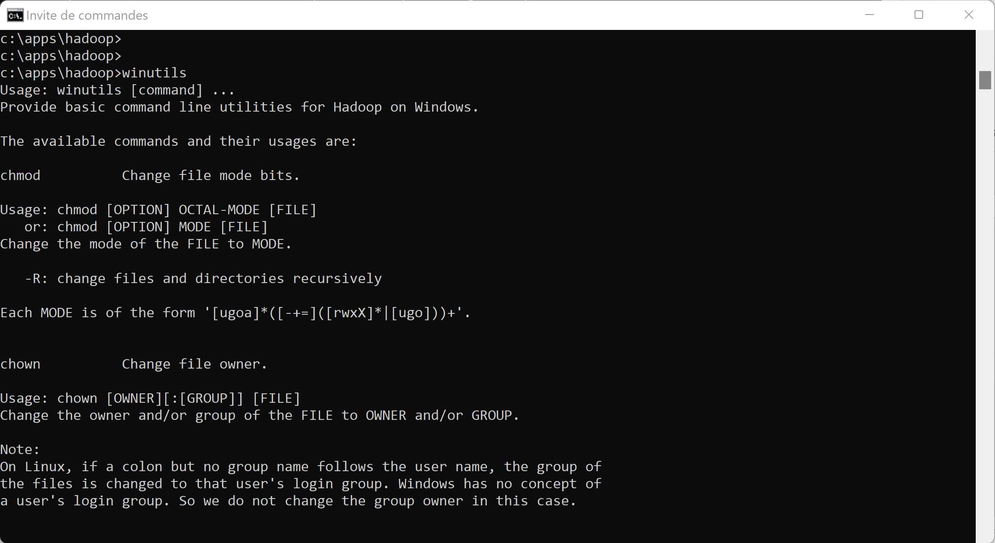
Sanity check: WinUtils

Slide 23
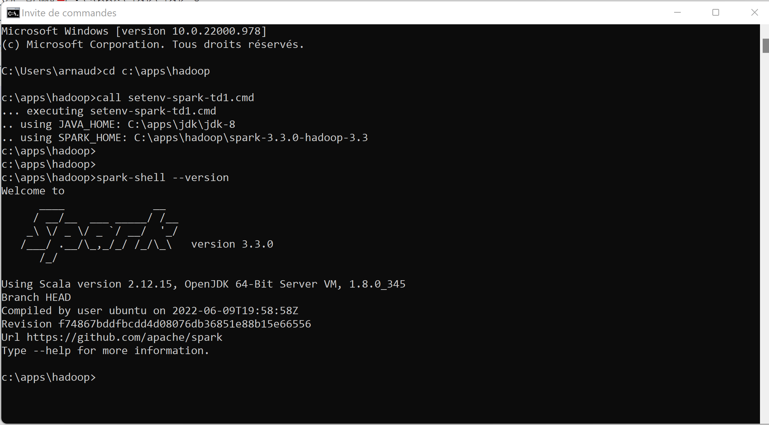
Sanity Check « spark-shell --version »

Slide 24
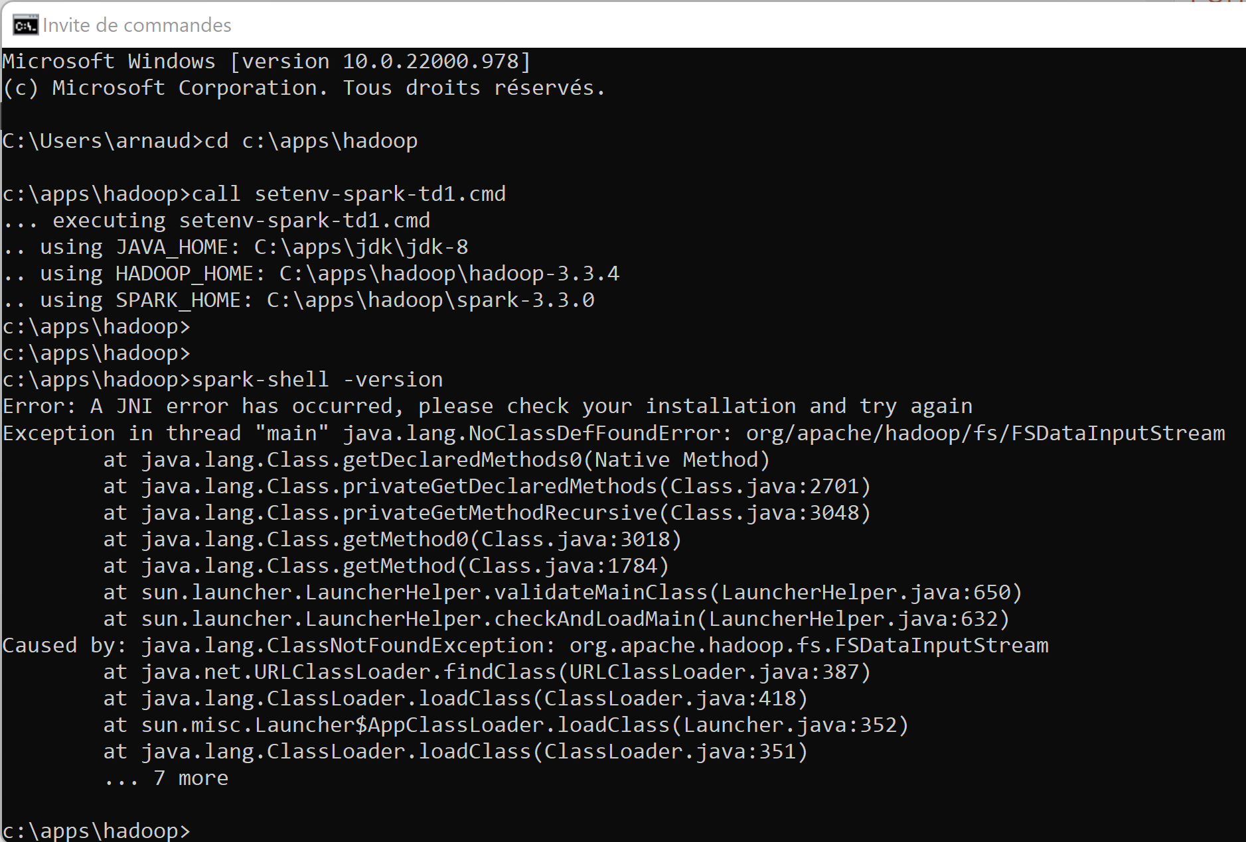
Spark and custom user-defined Hadoop? .. More difficult error when using JDK8 … but ok when JDK17 ?!
Naively think
missing hadoop jars
in spark classpath ?!
… NOT Only !!
Root cause
was jdk version +
Missing env var
SPARK_SCALA_VERSION

Slide 25
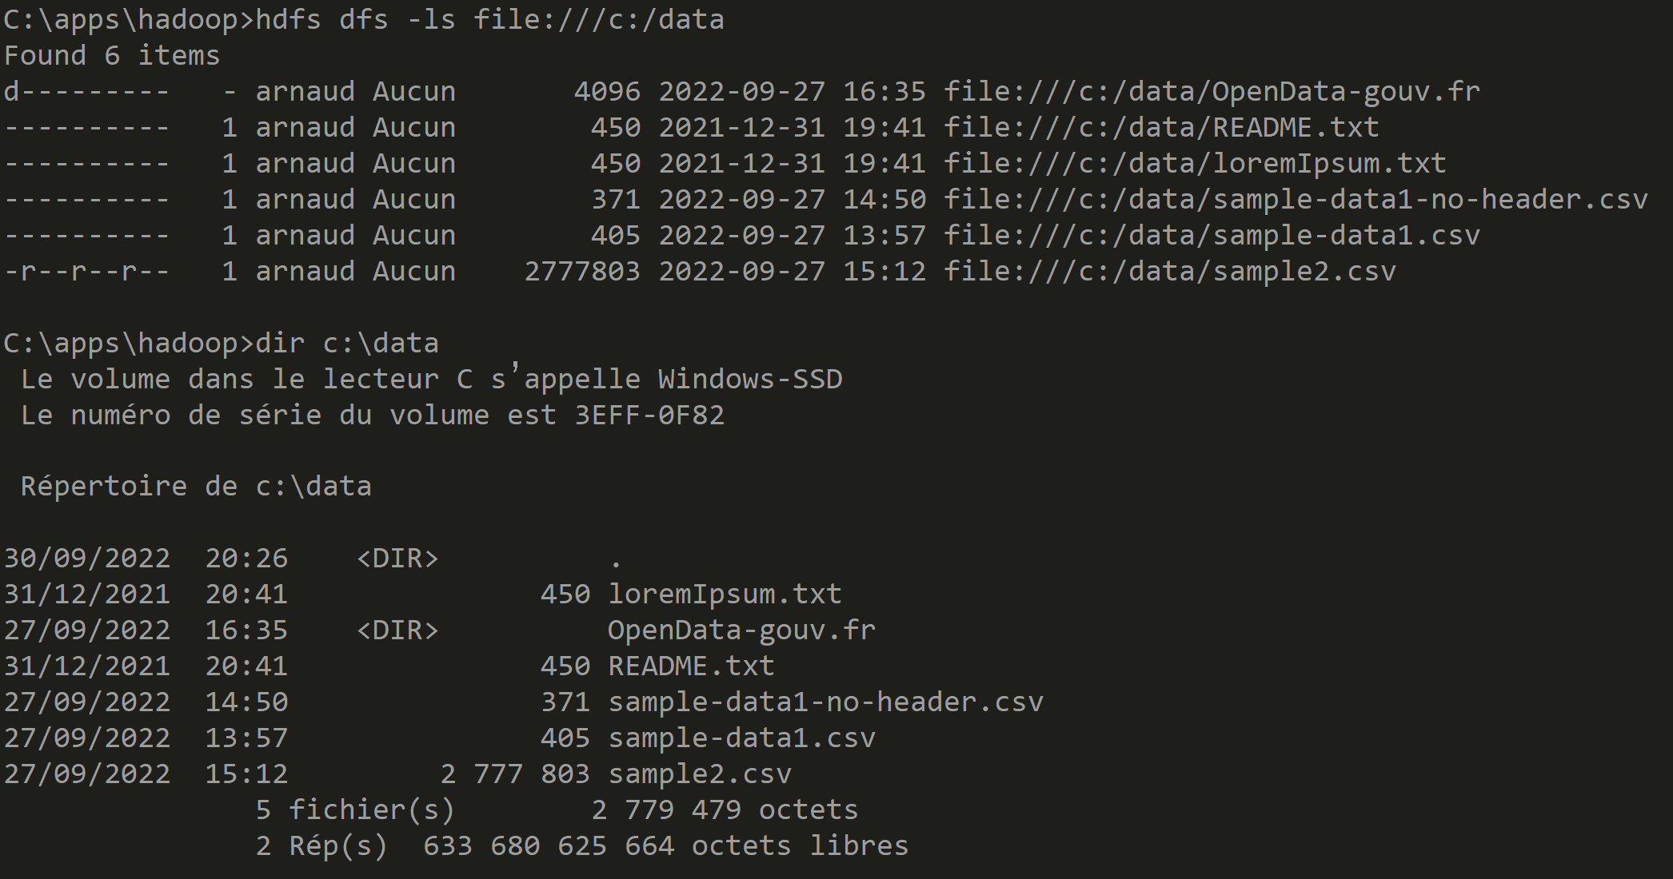
Optionnal when using custom Hadoop Sanity check HADOOP_HOME + PATH
C:> hdfs dfs –ls file:///c:/data

Slide 26
hdfs dfs –ls …
« hdfs dfs » is unix like commands for accessing Hadoop FileSystem
example
hdfs dfs –ls /some-hdfs-dir
# => implicitly converted to «hdfs dfs –ls hdfs://<hdfsServer>/some-hdfs-dir »
hdfs dfs –ls s3:// … for accessing Amazon S3
hdfs dfs –ls abfss:// … for accessing Azure Storage
hdfs dfs –ls file:///c:/local-dir … for accessing local dir ! Notice 3 slashes

Slide 27
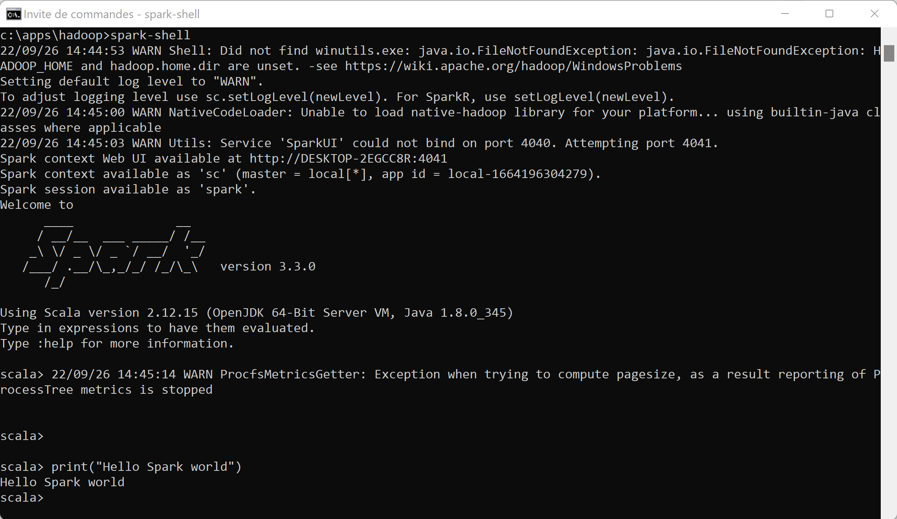
Spark-shell … print(« Hello World »)

Slide 28

Objectives
1/ Install on your (Windows) PC a minimalist local SPARK
2/ Configure it, launch spark-shell
3/ Discover spark-shell scala> REPL
4/ Execute basic spark commands on DataSets, Files

Slide 29
10 mn Pause

Slide 30
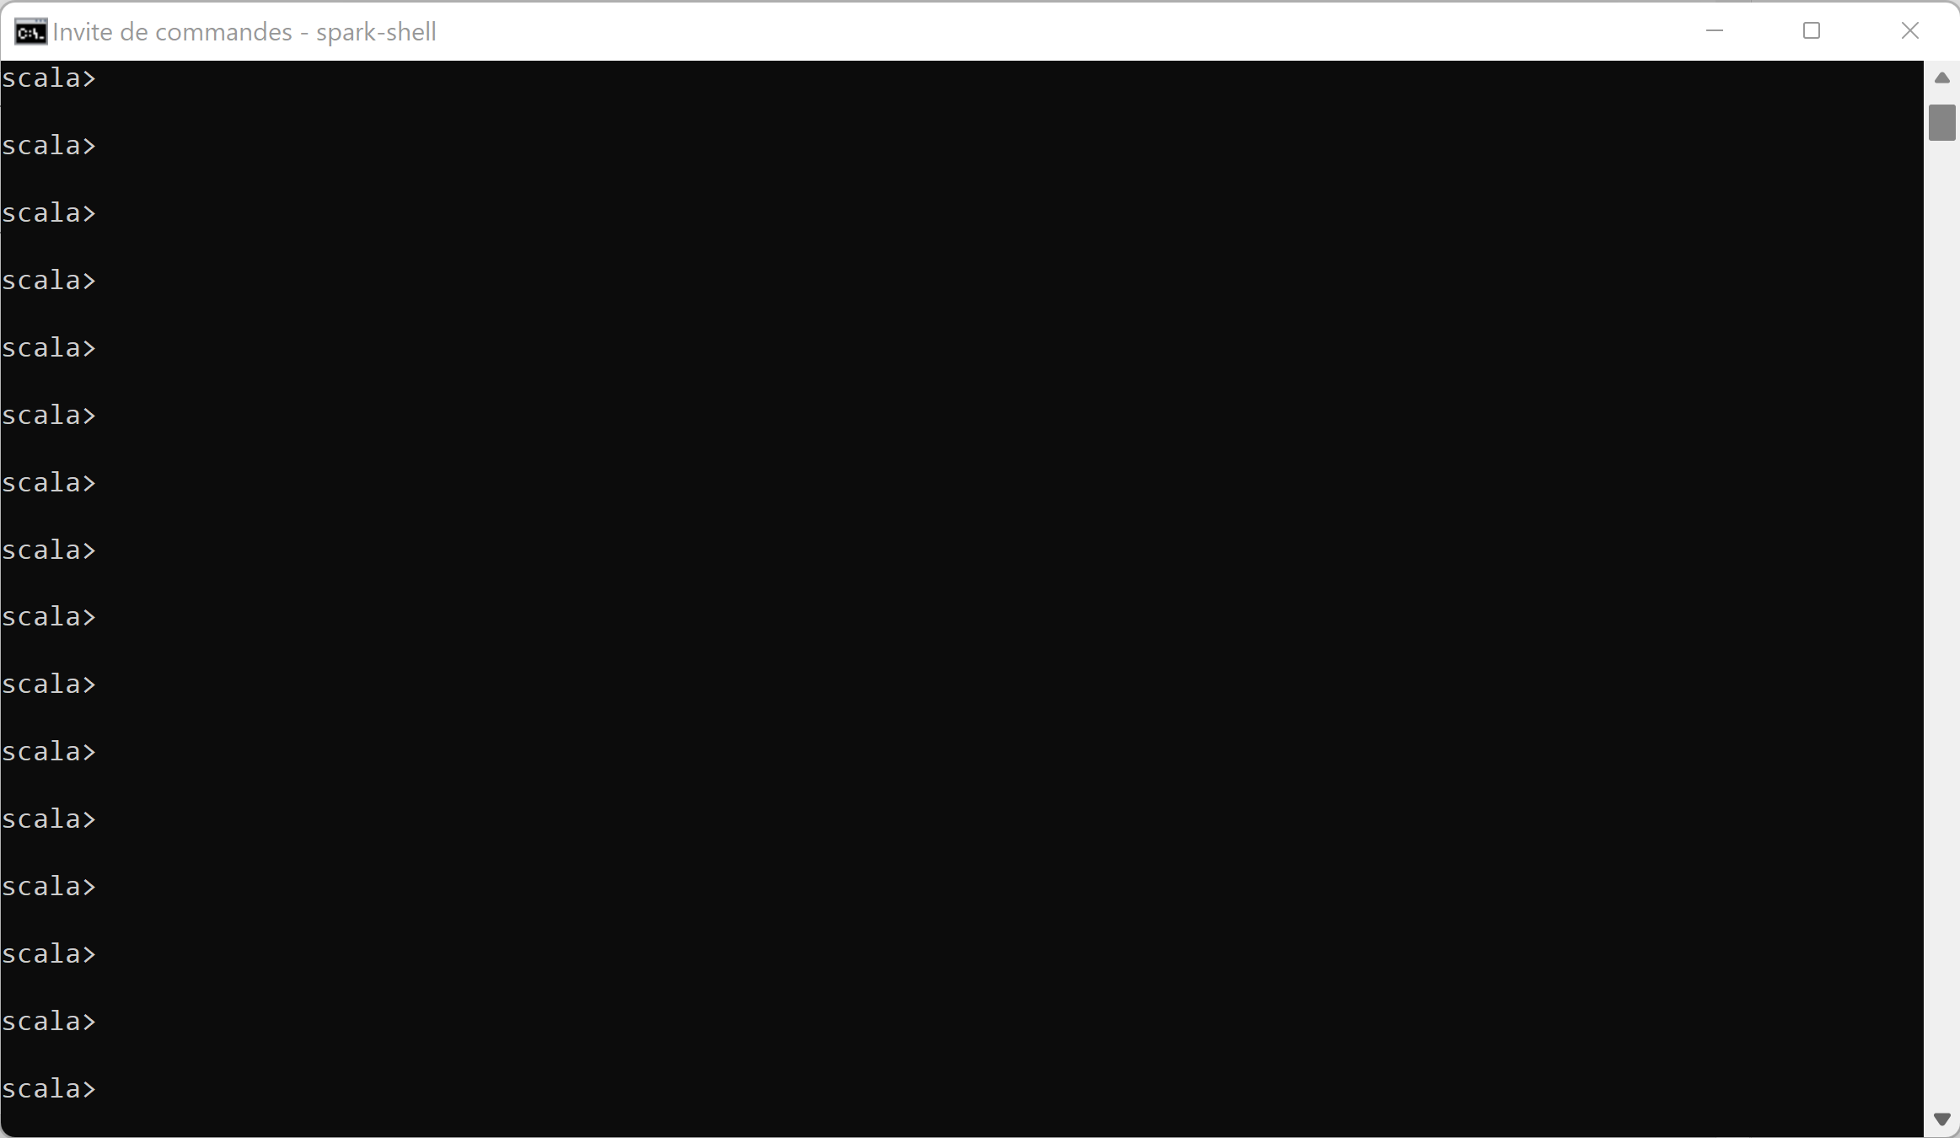
Discover Spark-shell type <enter> <enter> <enter> …

Slide 31
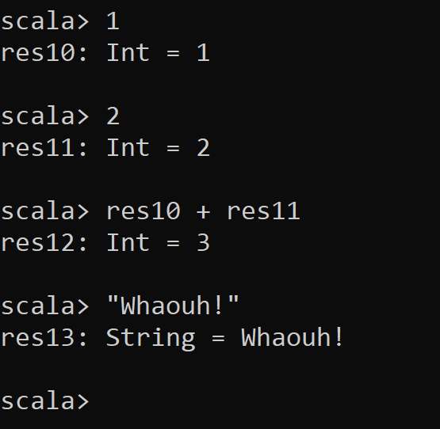
REPL = Read – Eval – Print - Loop
For each line,
Spark evaluate (compile in scala code)
Result is printed, with type information
and assigned to variable « res${i} » where « i » is incremented
Variables can be re-used by name

Slide 32
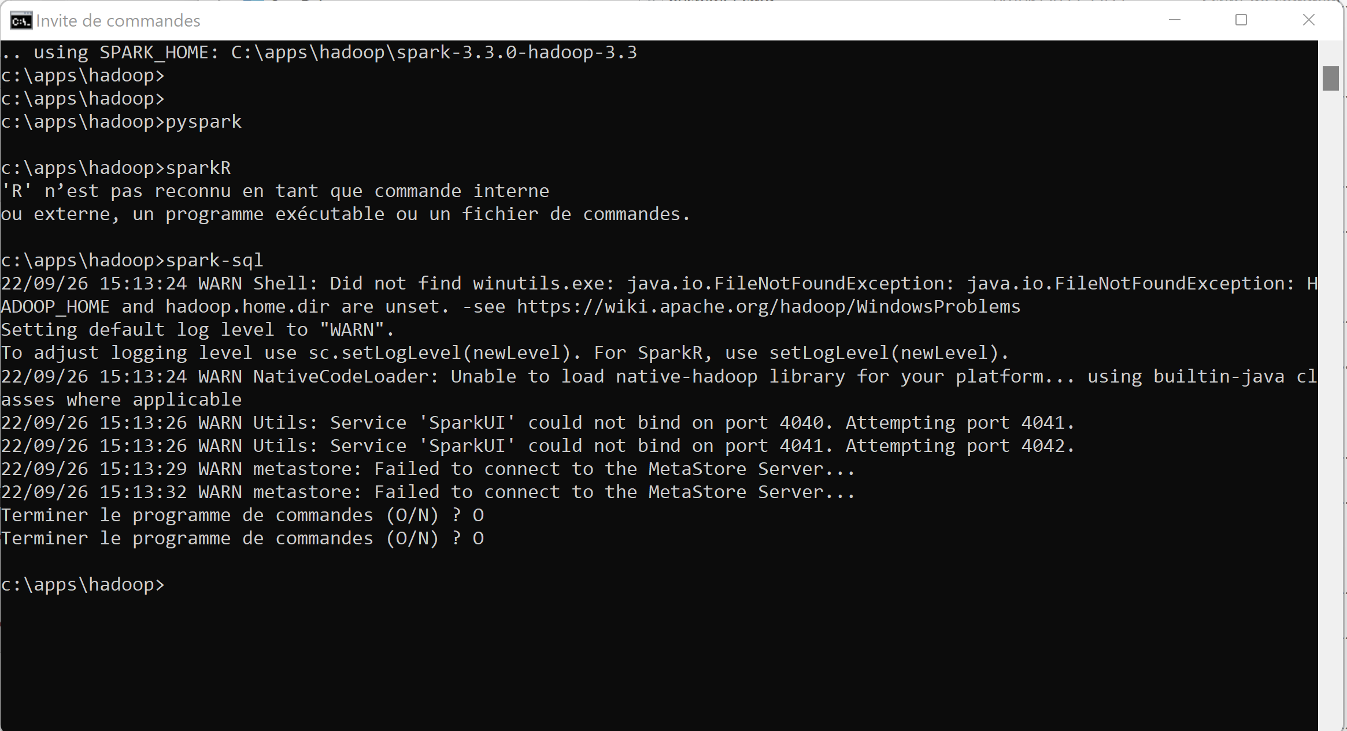
Not only spark-shell… pyspark => need python exe sparkR => need ‘R’ exe spark-sql => need connect to Hive MetaStore Server

Slide 33
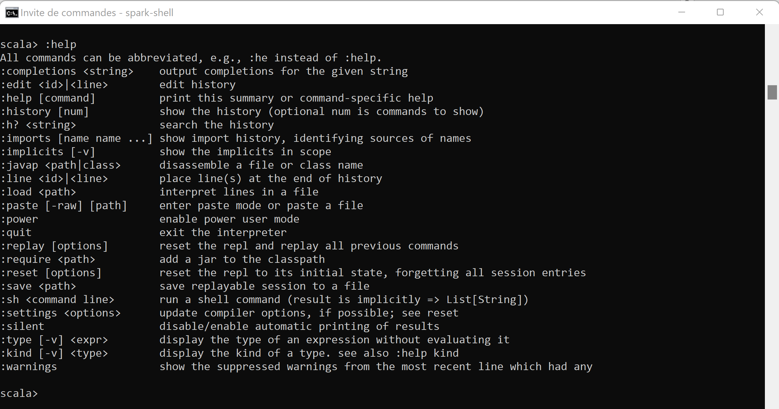
Discover built-ins commands, :help

Slide 34
Discover History
Exercise : a/ Type 5 basic commands: print(« line1 ») <ENTER> print(« line2 ») <ENTER> …. print(« line5 ») <ENTER>
b/ navigate scroll UP and Down to retype command N
c/ replay all commands, using « :replay »
c/ save session in file « my-supper-commands.txt »

Slide 35
Interactive Line Edit Jline ( ~GNU readline)
Remember the following standard shortcuts
CTRL+L : clear screen
CTRL+a / CTRL+e : jump to begin/end of line
CTRL+d : delete char
CTRL+k : kill rest of line, put in buffer
CTRL+y : paste line from buffer
Scroll Up / Down : previous/next line from history

Slide 36
Discover History (stop + relaunch spark-shell)
Exercise : a/ Stop you spark-shell
b/ restart a spark-shell
c/ do you still see your previous commands (Scroll Up)
d/ do you still see your history ?
e/ Find in which file are written your commands ? … search for hidden « .scala_history » file, in your home directory C:\users\<login>\.scala_history

Slide 37
Exercise using « :save », « :load »
a/ save all commands session in file « my-super-commands.txt »
b/ load and re-execute commands from file

Slide 38
Exercise using « :replay », « :reset »
a/ replay all in once your previous commands, using « :replay »
b/ reset commands… see History after

Slide 39
Discover Multi-Line edit support
How to type 1 command containing several lines ??
For example a for loop, with if –then-else
Or more realistic … SQL query on select line: SELECT … FROM … WHERE …
Answer:
Type « :paste » then copy& paste multiple lines… or simply type several lines with <enter> When finished, press « Control + D »

Slide 40
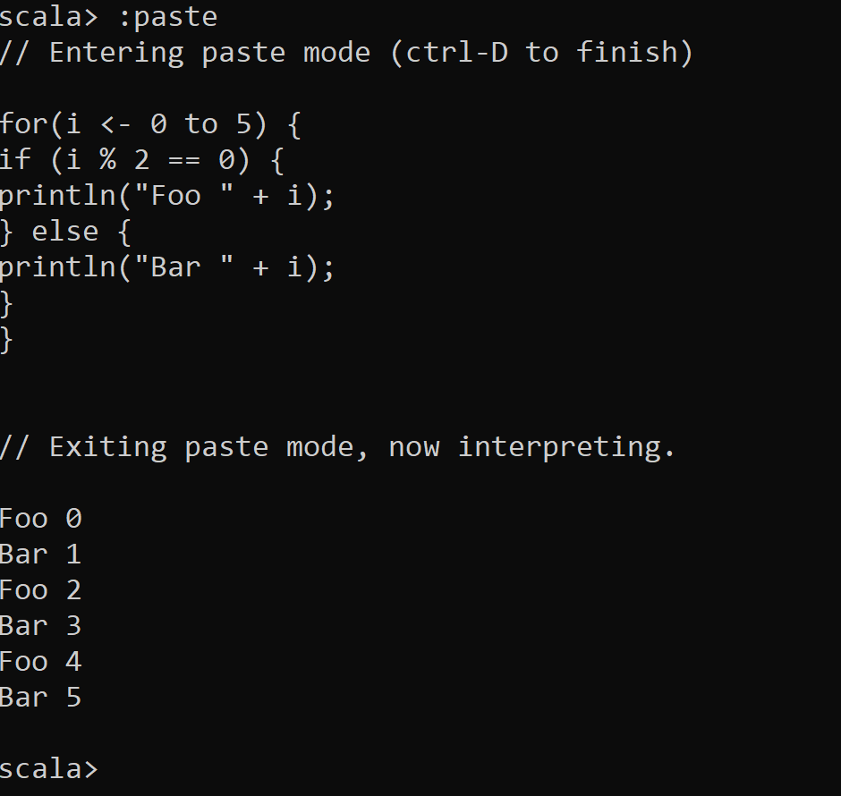
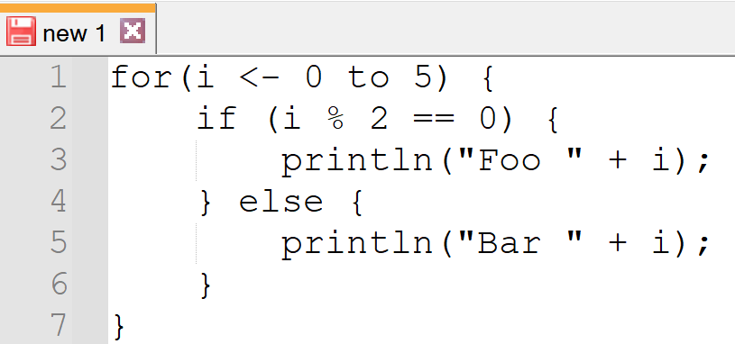
Using :paste … Control+D

Slide 41
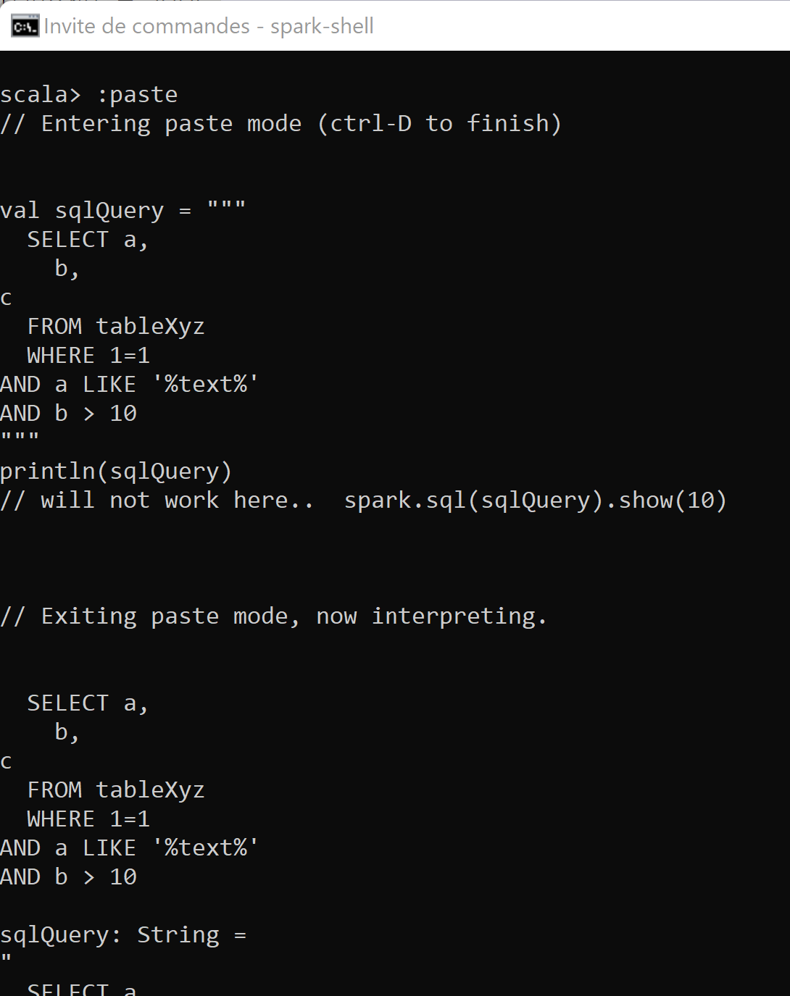
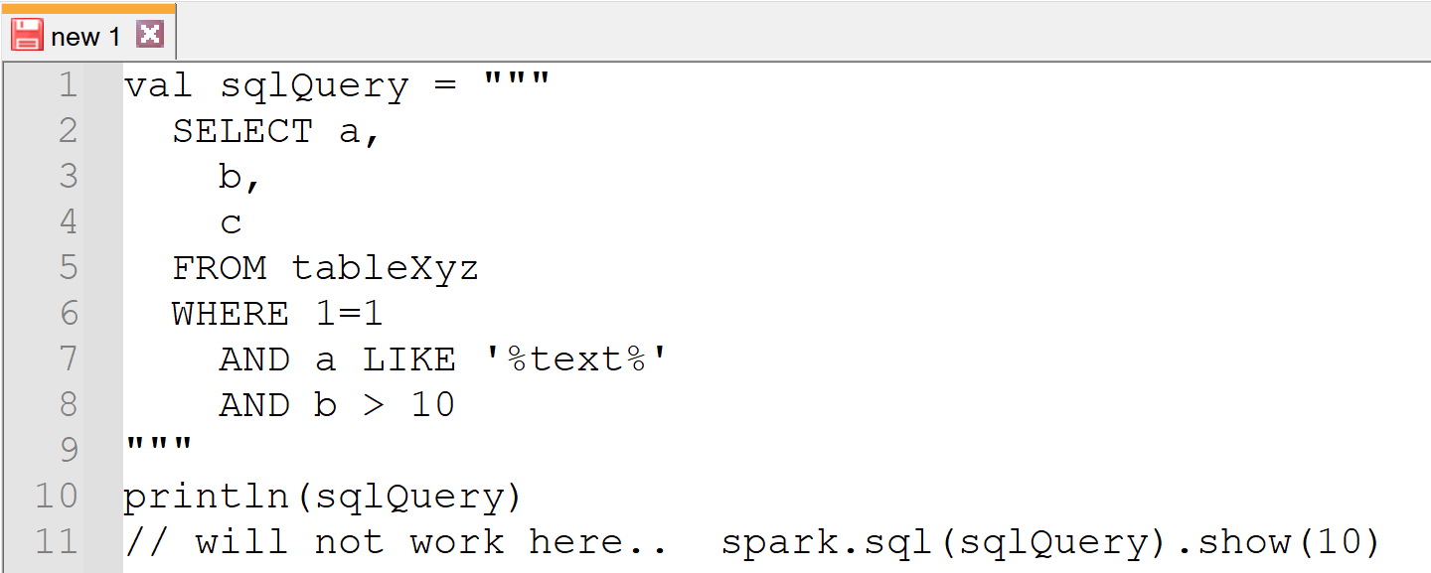
Using Multiple line String (example: SQL) triple quotes

Slide 42
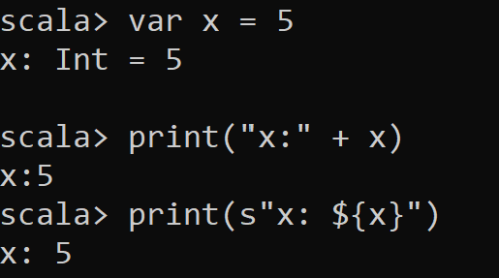
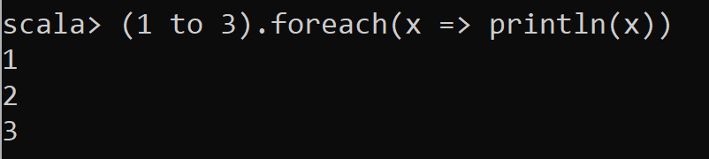
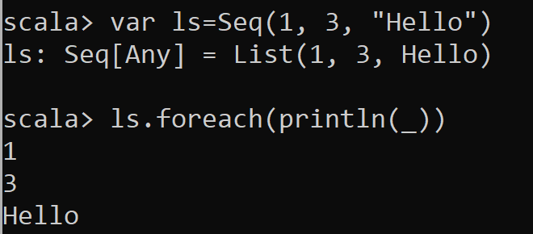
Spark-shell is a « REPL » for Spark in « scala »
Scala basic commands …
More Scala …
More Scala with … Sequence, implicit Lambda, « _ » var

Slide 43
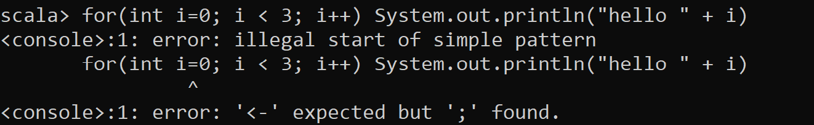
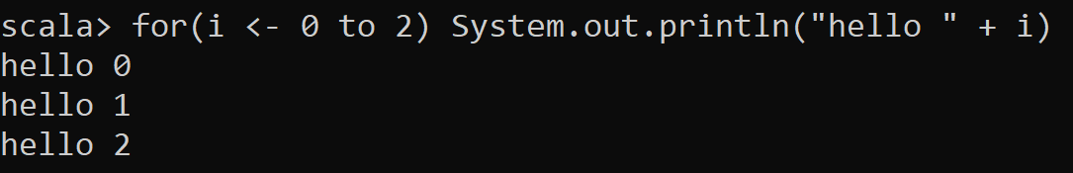
« Scala » .. ~ a super set of « Java » Scala runs on the JVM
… but not exactly

Slide 44
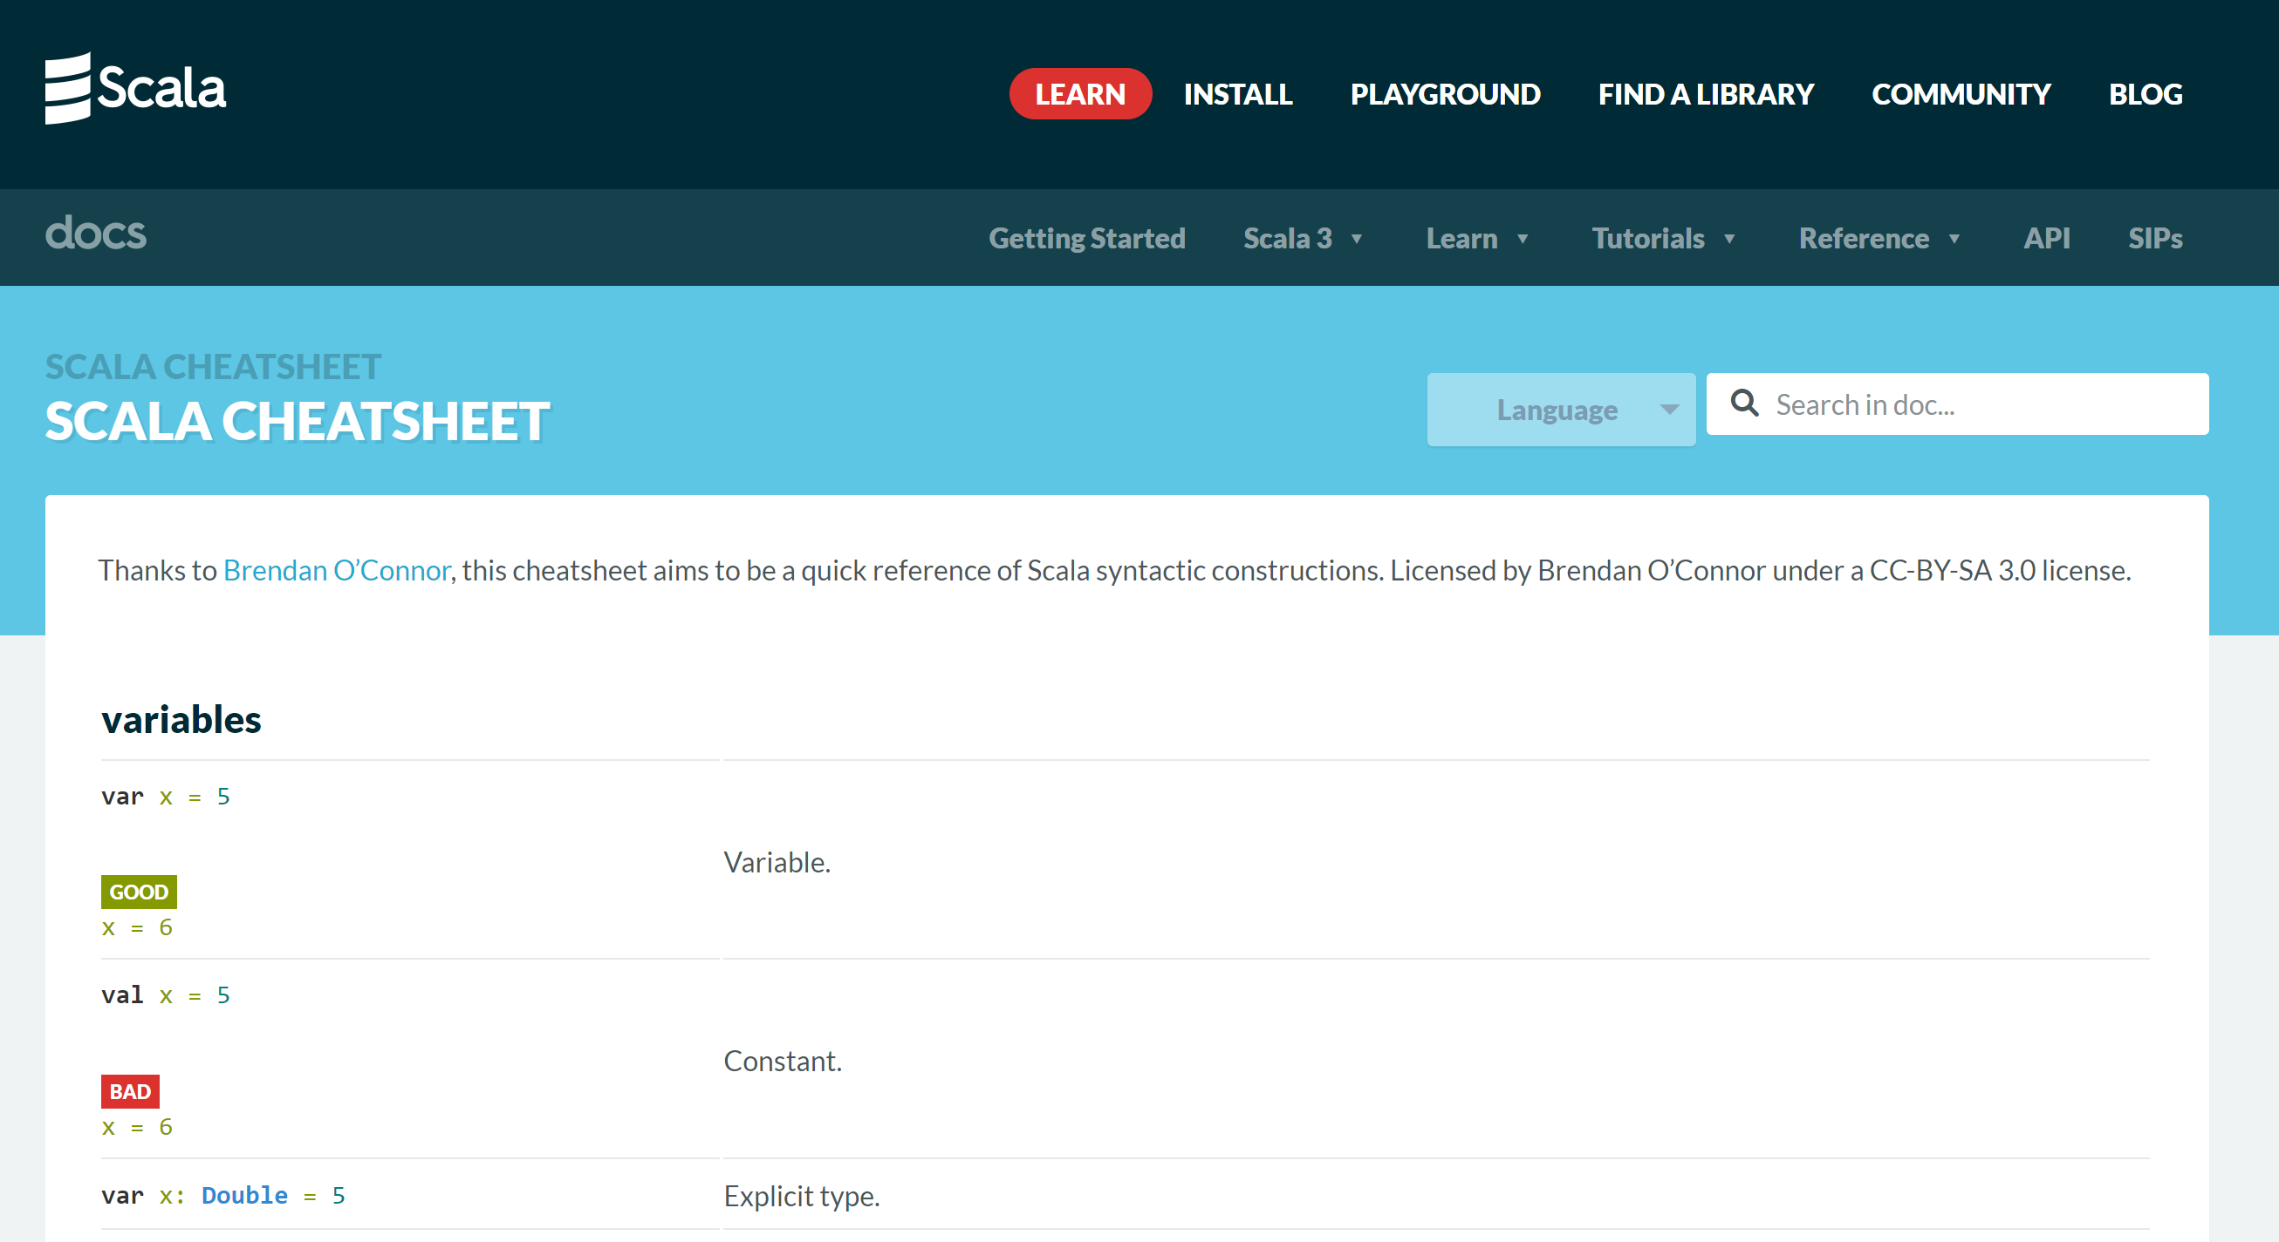
https://docs.scala-lang.org/cheatsheets/
5-10 minutes
Reading

Slide 45
Objectives
1/ Install on your (Windows) PC a minimalist local SPARK
2/ Configure it, launch spark-shell
3/ Discover spark-shell scala> REPL
4/ Execute basic spark commands on DataSets

Slide 46
Introduction to Exercises 1,2,3,4,5 … The goal is to create a spark DataSet..
Expected DataSet = List of 100_000 rows each row containing a Tuple of ( int : i, boolean : true if i is even, string: « hello ${i} » )

Slide 47
Exercise 1 : create a List of 3 Tuples
var ls = ???
With expected content: (1, false, "hello 1") (2, true, "hello 2") (3, false, "Hello 3")

Slide 48
Hint Exercise 1
In scala,
« (a, b, c) » creates a Tuple with 3 fields _1,_2,_3 with _1=a, _2=b, _3=c
« Seq(a, b, c) » create a Sequence (synonym: List) of 3 elements: a, b, c

Slide 49
Answer Exercise 1

Slide 50
Exercise 2: same, but create an empty List, and successively add 3 rows … the (non idiomatic) Java way

Slide 51
Hint exercise 2
List are immutable !
You can create a new List, as the concatenation of 1 element and an existing list
List has « :: » operator, not Seq !
var ls = List[Object]()
var ls2 = a :: ls
« a » and « ls » must have same generic type!
Use « List[Type] » instead of « List() »
Type is … (Int, Boolean, String)

Slide 52
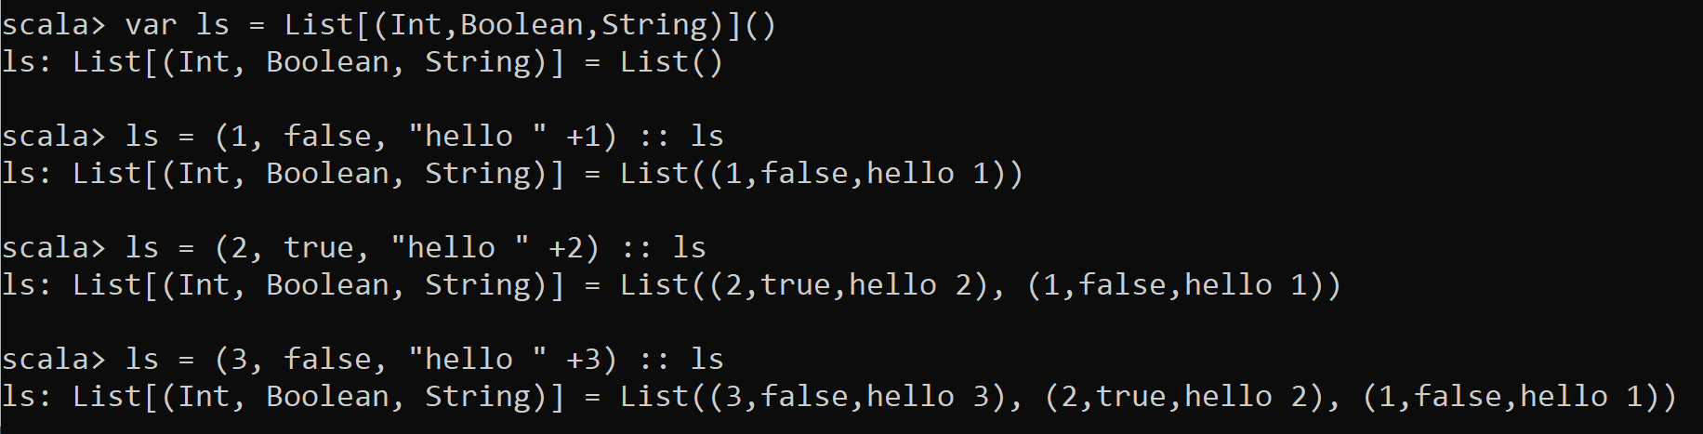
Answer Exercise 2 … the (non-idiomatic) Java Way..

Slide 53
Exercise 3 .. Same using « functional » code style: transform the sequence (1, 2 … 10000) into Tuples using « map » lambda function

Slide 54
Hint Exercise 3
« .map( f ) » is a method of List,
to map all elements from source type X to target type Y
taking a function « f » as parameter : « f(X) -> Y » … f can be written as a lambda: « x => { ..return y;} »
Source : List[X]
transformationFunction : X -> Y
target : List[Y]

Slide 55
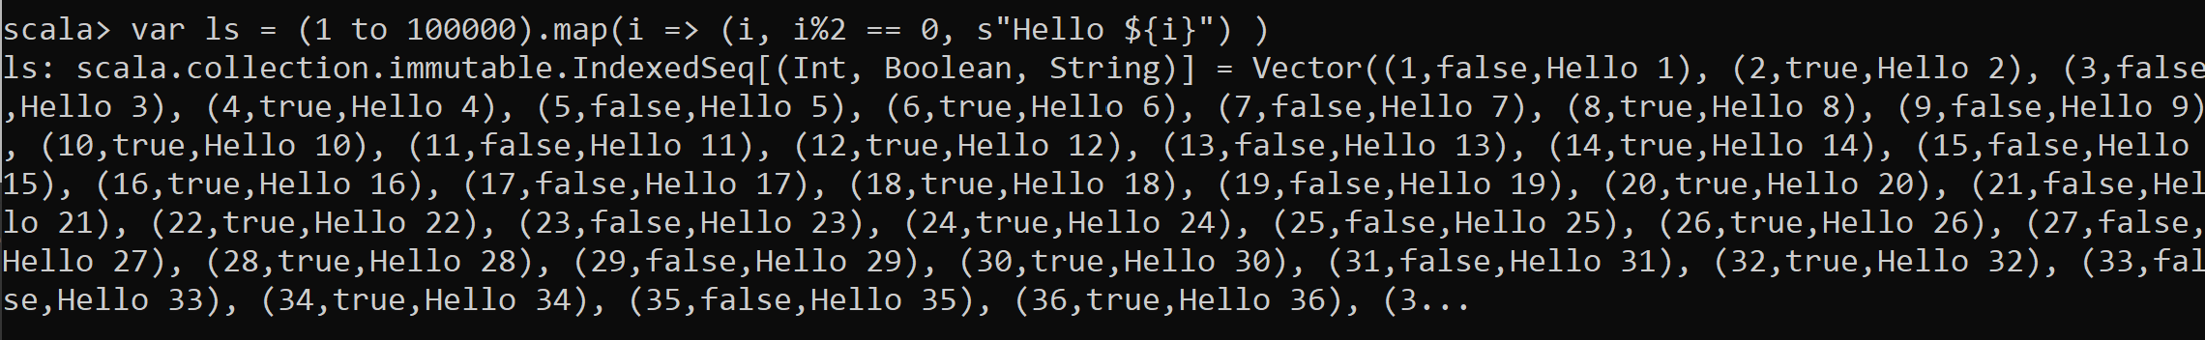
Answer Exercise 3

Slide 56
Exercise 4: display result from previous exercise 4a / display length of result 4b/ display row 0 tuple 4c/ display row 0, individual fields from tuple

Slide 57
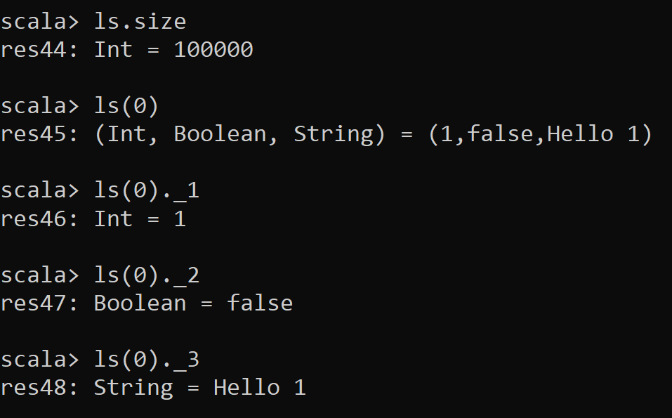
Answer Exercise 4

Slide 58
Exercise 5: create a spark DataSet of 100_000 rows each row containing a Tuple of int : i boolean : true if i is even string: « hello ${i} »

Slide 59
Hint Exercise 5
Just use
spark.createDataset() method
« spark » is a built-in variable
You can type « spark.create » and press TAB TAB to autocomplete

Slide 60
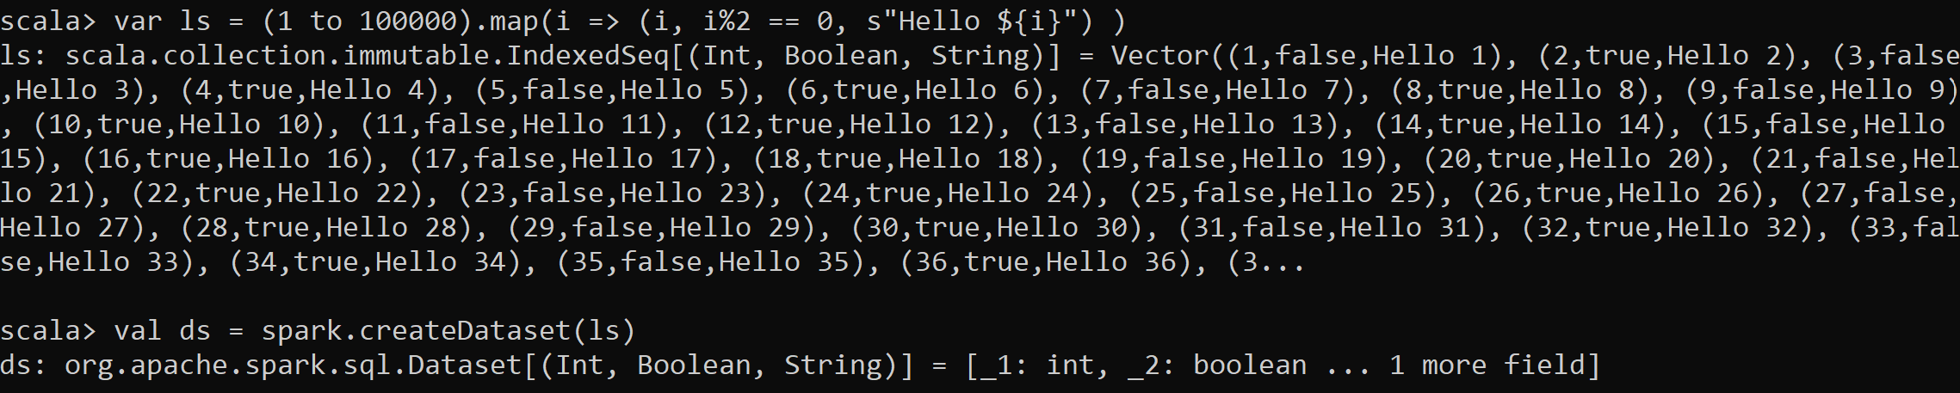
Answer Exercise 5
Equivalent 1-liner solution :

Slide 61
Exercise 6: Display result DataSet of ex. 5
6a / display number of rows
6b/ show first rows (default: 20)
6c/ show only first 2 rows
6d/ show individual columns of row0

Slide 62
Hint Exercise 6
Like on Seq or List … Dataset accept many methods,
like « .show() », « .count() », « .take() » etc.

Slide 63
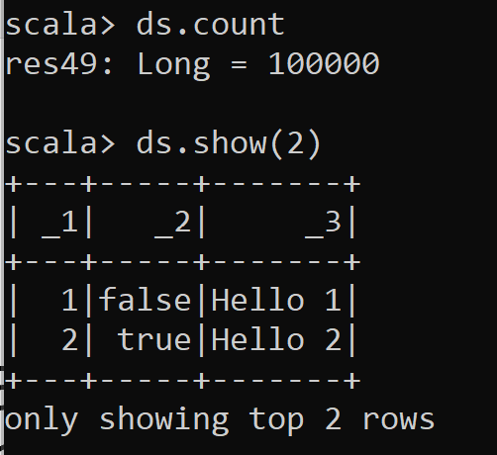
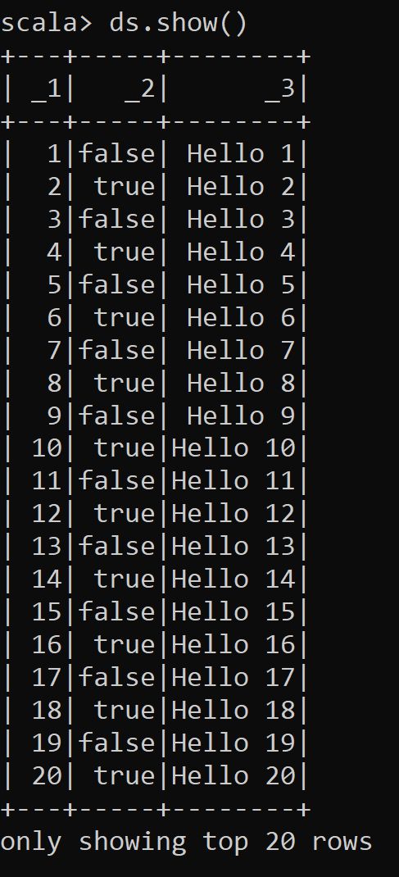
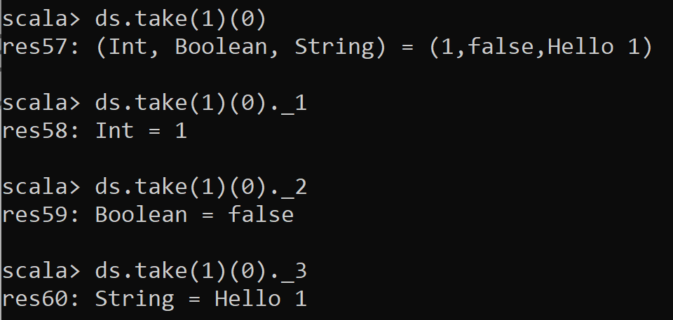
Answer Exercise 6
By default… « .show() » => same as « .show(20) » .. => same as « .show(20, true) »

Slide 64
Exercise 7: Rename columns
Rename columns _1,_2,_3 to « id », « even », « text »

Slide 65
Hint Exercise 7
Use dataset.withColumnRenamed()
… remember Dataset are immutable !
Most Dataset method returns a new Dataset
so cascade calls (or assign intermediate results)
repeat the operation 3 times

Slide 66
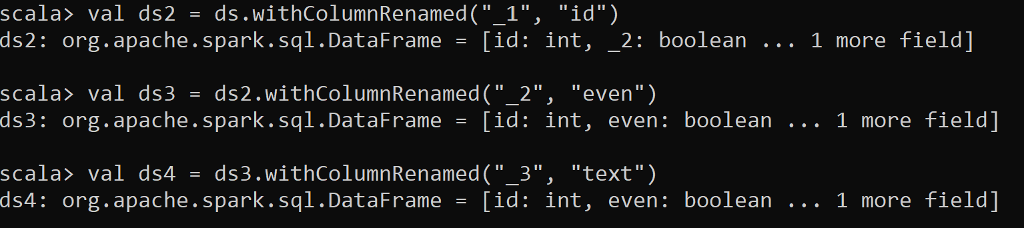
Answer Exercise 7
Ds … is unmodified … still has _1, _2, _3 columns
More idiomatic: cascade methods

Slide 67
Exercise 8
Filter rows where « id » is « >= 100 »
Using « filter(Column) » operators
To create an expression on column « id » of dataset « ds »,
You can use « ds(« id ») » OR implicit equivalent $«id »

Slide 68
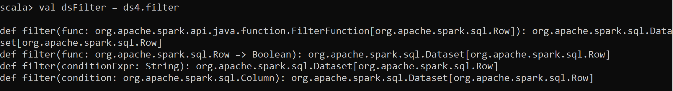
Hint Exercise 8
Type « .filter» and pres TAB TAB to autocomplete
You can see there are 3 possible overloads for method
use « .filter( ds(« columnName») operator… ) »
It is more complex than using SQL conditionExpr… cf exercise 9
But It is simpler than exercise 10 … using lambda predicateFunc : row -> boolean

Slide 69
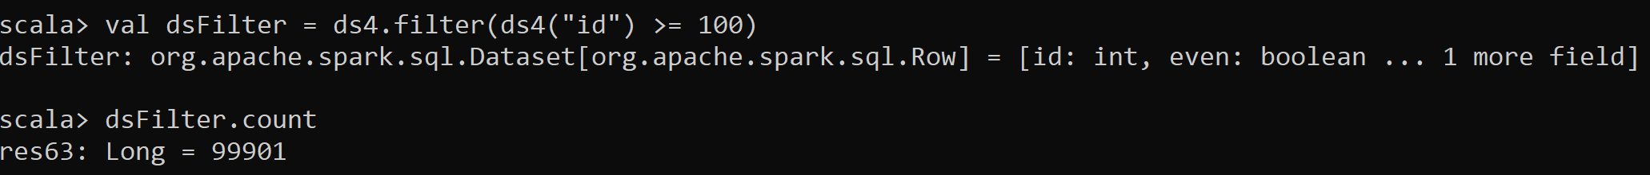
Answer Exercise 8
utlisation de l'api BAS-NIVEAU "Column" expression
val ds5 = dataframe.filter( dataframe.col("value").gt( lit (100) ) )
val ds5 = dataframe.filter( dataframe.col("value") > lit (100) )
val ds5 = dataframe.filter( dataframe.col("value") > 100 )
val ds5 = dataframe.filter( col("value") > 100 )
val ds5 = dataframe.filter( $"value" > 100 )

Slide 70
Exercise 8
Filter rows where
« id » is « >= 100 » AND
«text » contains substring « 12 »

Slide 71
Hint Exercise 8
Spark as overriden most of the natural operators on class « Column »
Including >=, &&, ||, !, contains, …
You can manipulate columns objects almost as values in scala

Slide 72
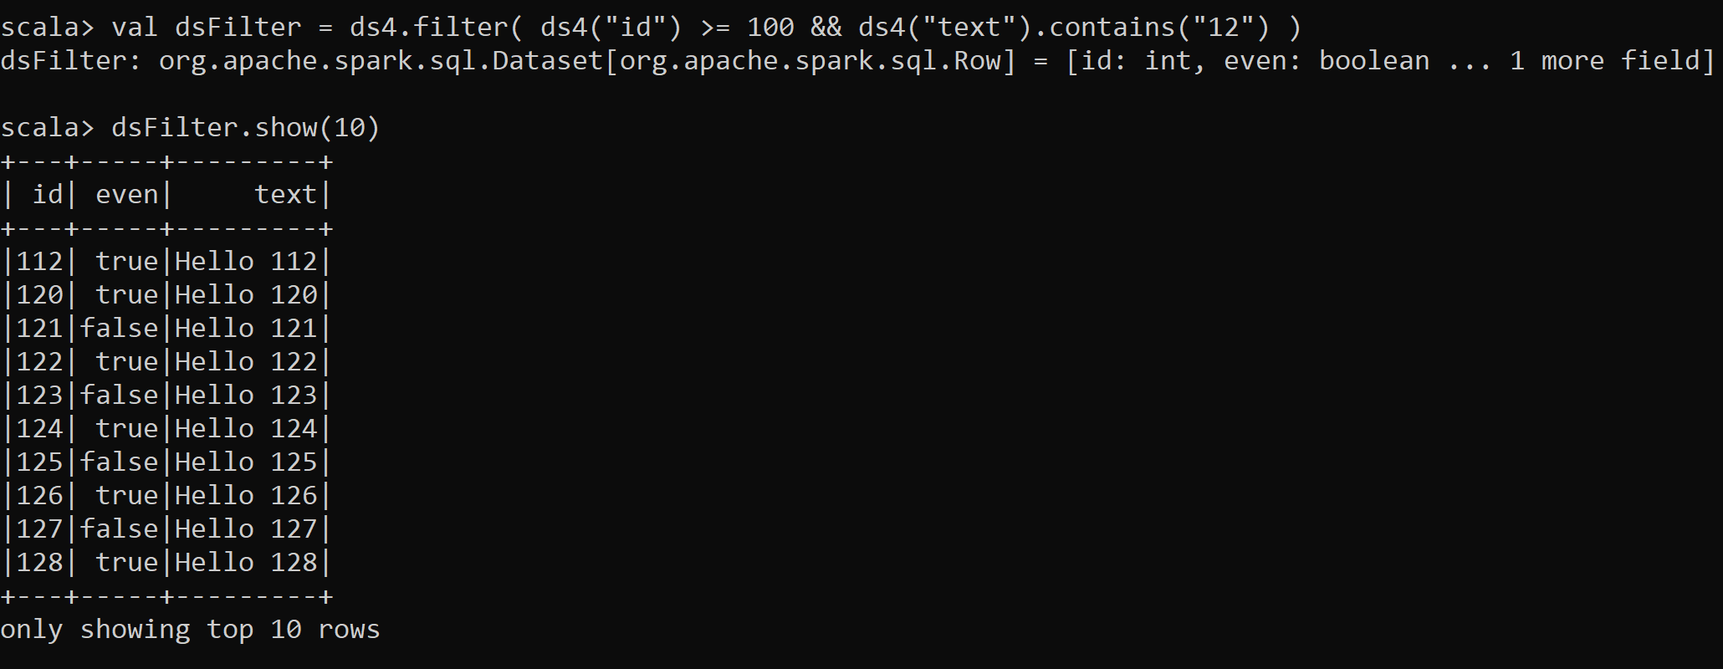
Answer Exercise 8

Slide 73

Alternative Answer Exercise 8

Slide 74
Exercise 9
Redo exercise 7,8 using filter by SQL text expression

Slide 75

Answer Exercise 9

Slide 76
Exercise 10
Same as exercise 7,8,9… but using « .filter(row => …) »
i.e. Filter with lambda function on row
Use getAs[Type](« columnName ») to extract the value of a column, and cast

Slide 77
Hint Exercise 10
Method signature is
.filter( (or.apache.spark.sql.Row row) => boolean)
You need to extract column value for object « Row », and interpret as Int or String
for column « id » as Int … use « row.getAs[Int]("id") »
For column « text » as String … use « row.getAs[String](« text") »

Slide 78

Answer Exercise 10

Slide 79
Exercise 11 : same as exercise 1 (on Tuple), but using your own custom « case-class »
Declare a scala case-class (also named Bean, POJO or Record in java)
To replace the Tuple « (Int,boolean,String) » of exercise 1
Should be equivalent to java class:
public class CustomBean {
public int id;
public boolean even;
public String text; public CustomBean(int id, boolean even, String text) {
this.id = id; this.even = even; this.text = text;
}
}

Slide 80

Answer Exercise 11

Slide 81
Exercise 12 : Same as Exercise 5,6,7,8,9 .. Using CaseClass
https://spark.apache.org/docs/latest/sql-getting-started.html#creating-datasets
a/ create a List of 100 000 CustomBean objects, using map + lambda function
b/ create a Dataset[CustomBean] with 100 000 rows
c/ display results : show 10 rows, show row 0, show individual fields of row 0
d/ filter Dataset with « id > 100 and text contains ’12’ »

Slide 82

Answer Exercise 12

Slide 83
Exercise 13 : convert to DataFrame (Dataframe = Dataset<Row>)
a/ What was the type of « ds » (from exercise 5) ?
b/ What is the type of « dsFilter » (from exercise 8) ?
c/ What is the type of « beanDs » (from exercise 12) ?
d/ Convert a Dataset of tuple « ds » (from exercise 5) to a spark DataFrame
e/ Convert a Dataset of custom Bean « beanDs » (from exercise 12) to a spark DataFrame

Slide 84


Answer Exercise 13
Type, then conversion:
After a filter() operation, Spark has already enterred the magic DataFrame world !
Converting CustomBean->DataFrame… same as Tuple -> DataFrame

Slide 85
Exercise 14 : Question
Do you understand the in-memory difference between ? a/ in memory scala collection of Tuple: Set( Tuple ( …) ) b/ Dataset on scala Tuple: Dataset[ ( ..Tuple ) ]
c/ Dataset on custom class Dataset[ YourCustomBean ]
c/ DataFrame …. Dataset[Row] … means YourCustomBean is the preferred spark one: « Row » What do you think is the most efficient for developping type-safe code, and internally for Spark ?

Slide 86
Answer Exercise 14
Scala collection are only on the Spark driver side
… you may not be able to instanciate 500 Giga otects of these
Dataset (and DataFrame) are distributed over spark executors
To send data over the network, they are serialized then un-serialized.
So it is still real « Tuple » or « CustomBean » object pointers, but on spark executors.
Dataset[Row] is special … Spark internally is able to handle native memory / swap storage.

Slide 87
Exercise 15: question
When do you use { ._1, ._2 } ?
When do you use { .id, .text } ?
When do you use { .getAs[Int](« id »), .getAs[Int](« text ») } ?

Slide 88
Answer Exercise 15
On scala Tuple => you use _1, _2, … field names
On your custom bean => you use your class fieldName (or getter) Example: case class YourCustomBean(id: Int, text: String, foo: String) {}
val bean = YourCustomBean(123, « text », « foo »);
bean.foo
In SQL expression, you use the column name, example « _1 », « id », « text »
On spark.sql.Row => you use org.apache.spark.sql.Row methods !! Example: row.getAs[Int](« foo »)

Slide 89
Exercise 16 : MindMap
Draw a MindMap to summarize
what you did and learn from this TD session
Your MindMap should
start with word « spark-shell » in the middle
Then draw star edges to other word chapters and sub-chapters

Slide 90
Hint Exercise 16
DataSet
Installation
Spark-Shell
Interactive
Functionnal
Code Style
Scala>
Repl

Slide 91
Objectives
1/ Install on your (Windows) PC a minimalist local SPARK
2/ Configure it, launch spark-shell
3/ Discover spark-shell scala> REPL
4/ Execute basic spark commands on DataSets

Slide 92
Take-Away What You learned ?

Slide 93
Mind Map
Set JAVA_HOME
Set SPARK_HOME set PATH
JVM
WinUtils
Transform, filter
Setenv.bat
DataFrame=Dataset[Row]
Pre-Requisite
Val ds = spark.createDataset()
Spark.tar.gz embedded Hadoop
ds.show(10, true)
DataSet
Installation
User-defined
Hadoop.tar.gz
Immutable
Spark-Shell
Interactive
Windows error?
avoid
for () {} loop
Functionnal
Code Style
History
Seq
.map
lambda
Up / Down
Scala>
Repl
:help
TAB TAB autocompletion
Line compiled to scala
Eval on <enter>
val i =
var i =
Seq()
Tuple
On JVM
~Java
Numbered result « res0,res1,.. »

Slide 94
Questions ?

Slide 95
Next Steps
More CMs
More TDs
Spark concepts:
File Input / Output
PARQUET columnar files
SQL
Spark Clustering
DAG, Distribution, Optimizations
Java binding, UDF, map
Spark Streaming
…

